Slide 1
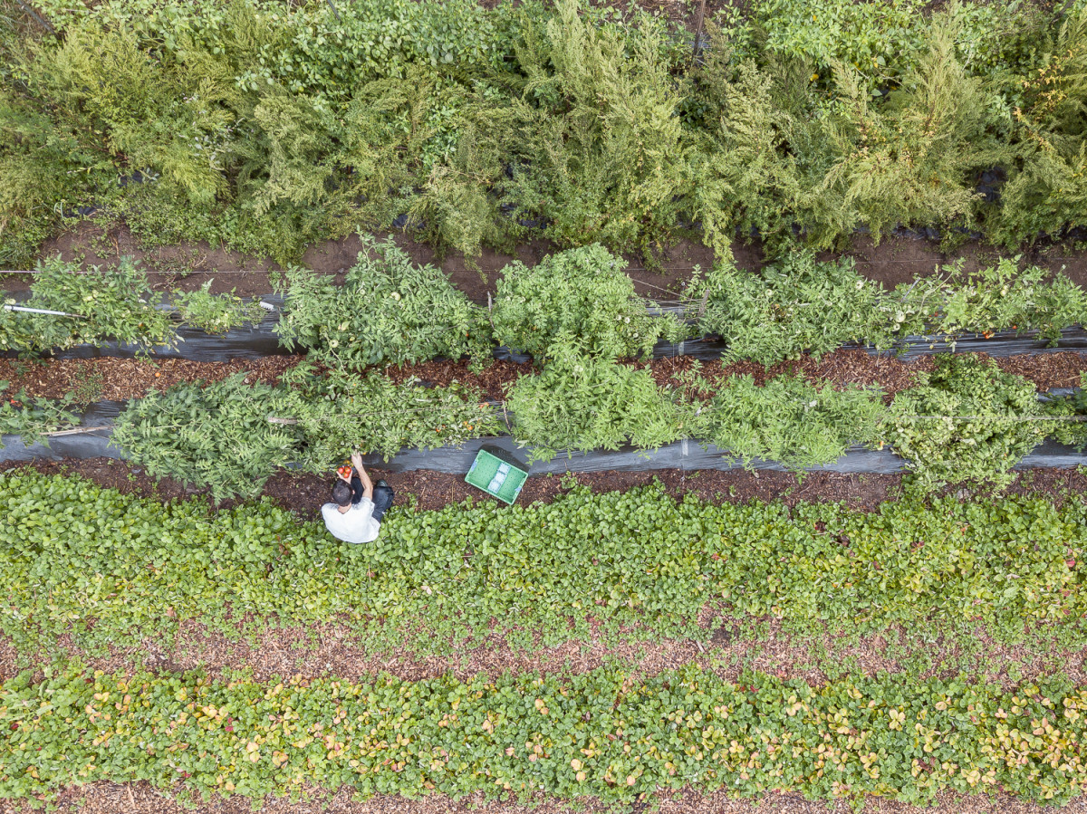
2020 Tomato Tasting Lab
Caleb Poppe
Evergreen State College
SURF representative

Slide 2
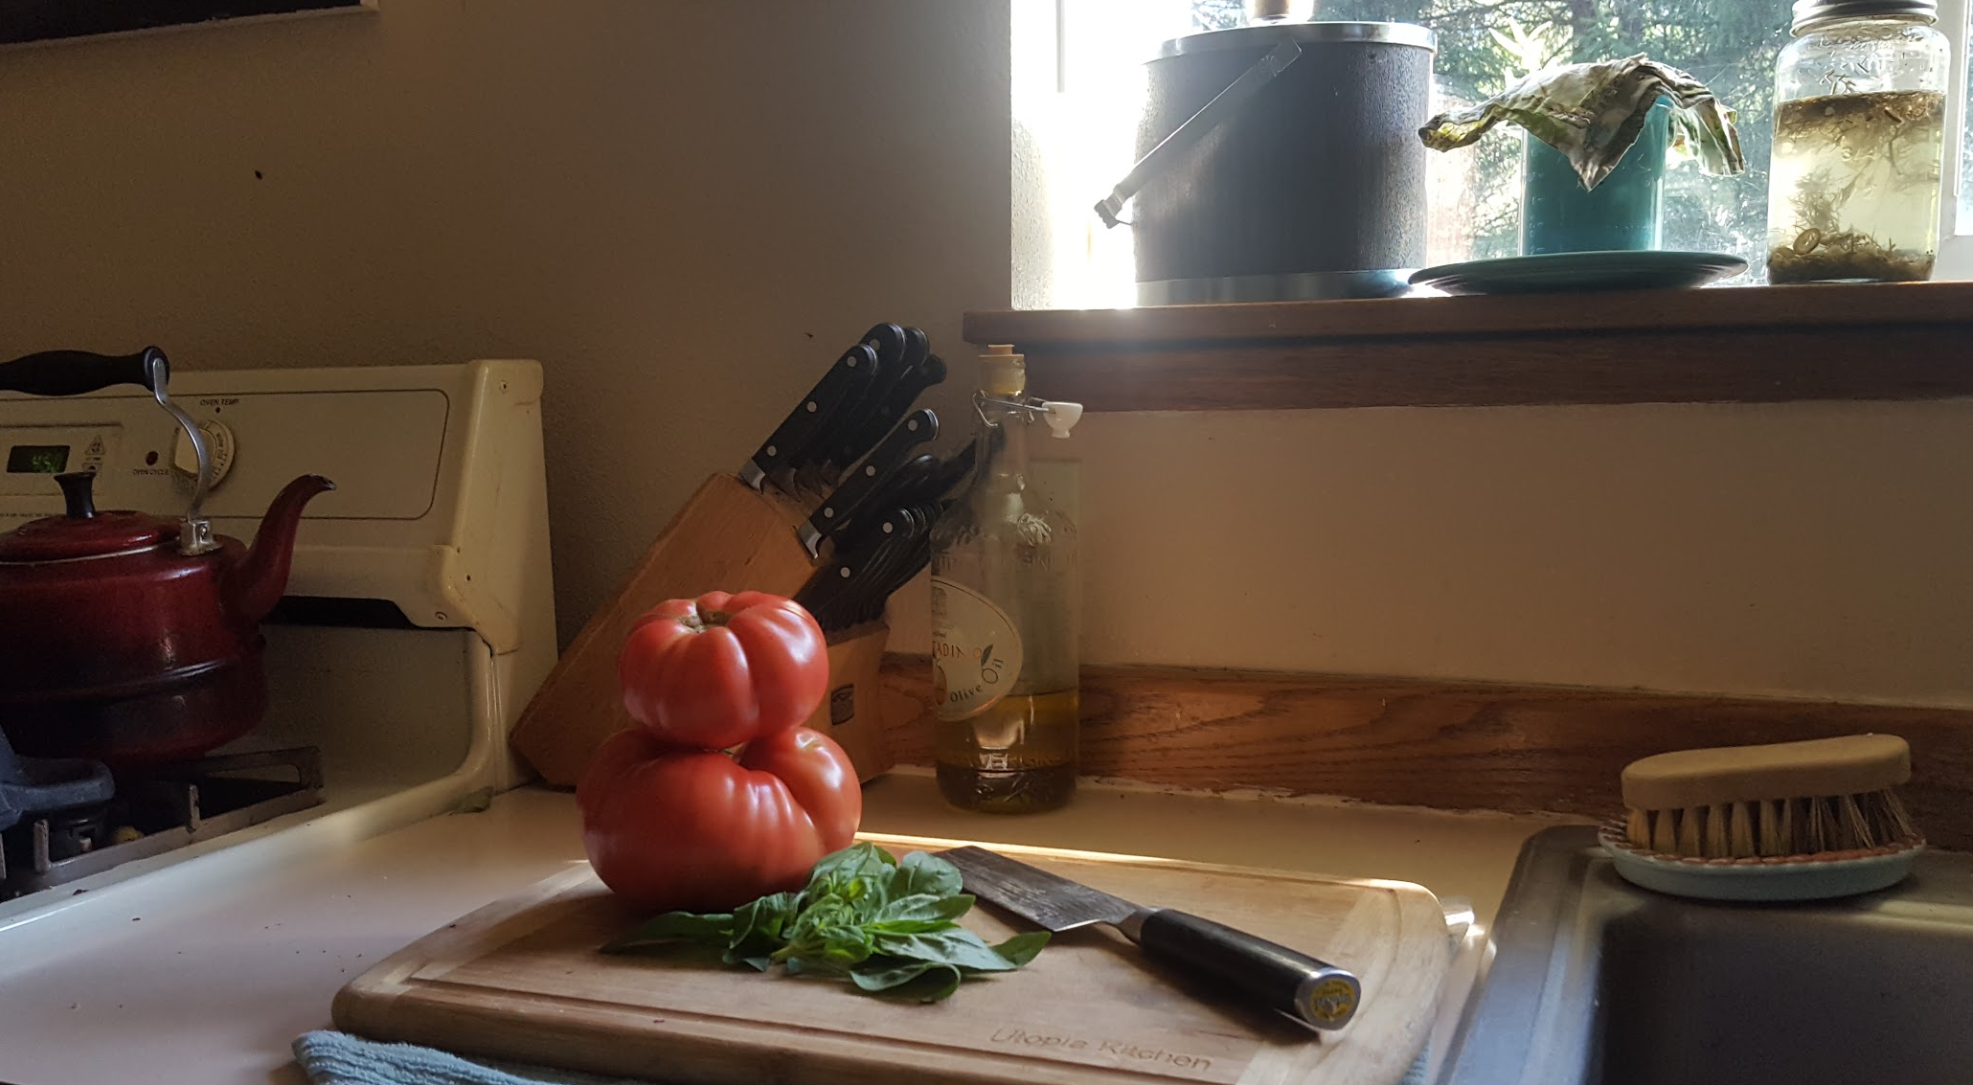
What are we doing today?
Gorging ourselves with tomatoes
Enjoying time spent with peers
Evaluating distinguishing factors between multiple varieties of tomato fruit
Learning about the differences from one tomato to the next
Supplying data for your good ol’ friend Caleb
Maybe getting tired of looking at tomatoes

Slide 3
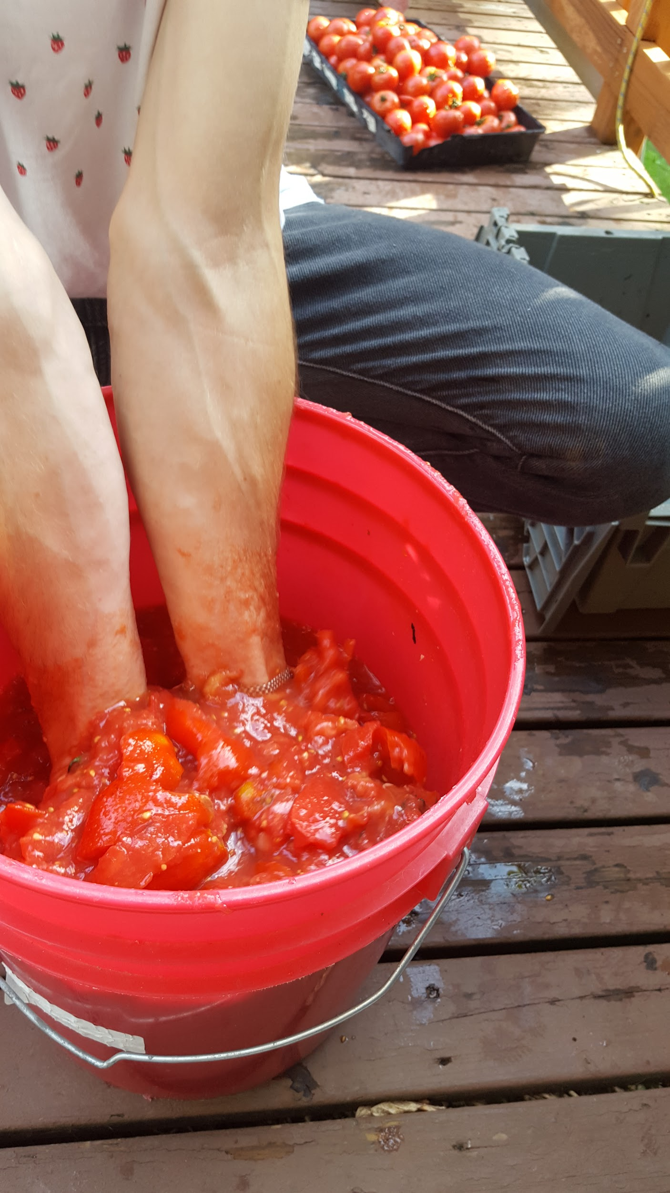
Why are we doing this?
Taste is a rather important aspect of tomato breeding work!
Growing tomatoes in the Pacific Northwest is _______!
Supporting ethical and sustainable seed-saving practices help us to enjoy many more tomatoes.

Slide 4
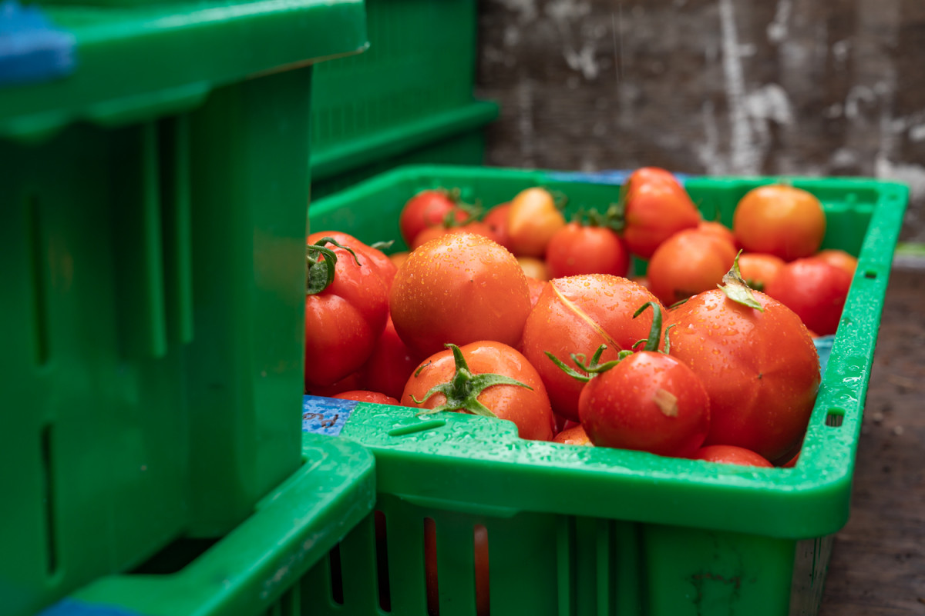
What are some different types of tomatoes??

Slide 5
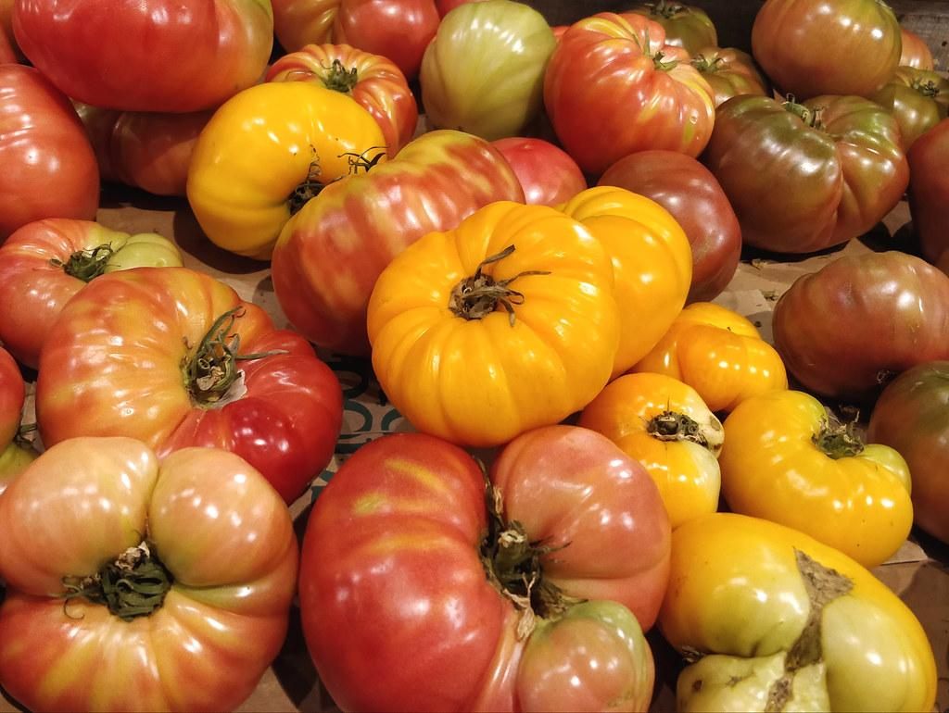
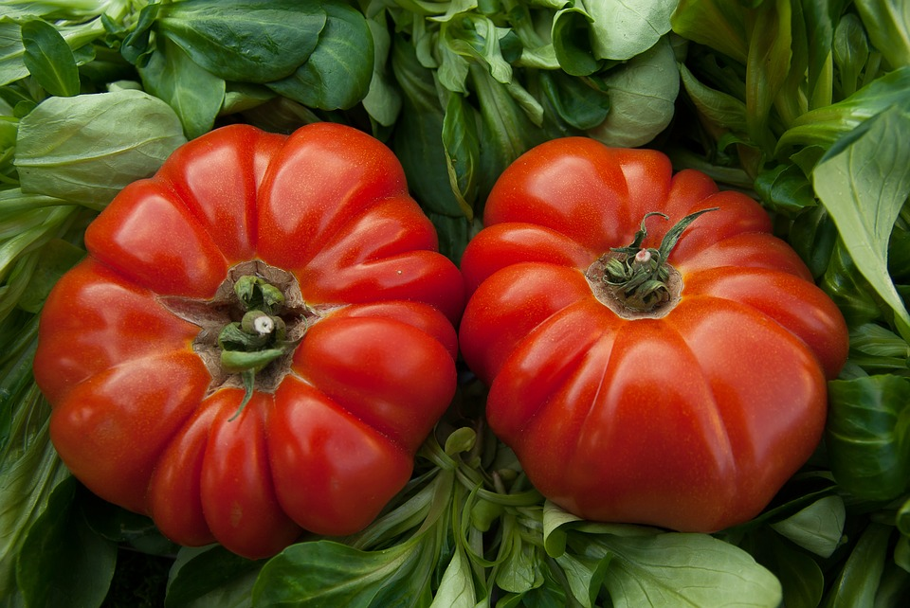
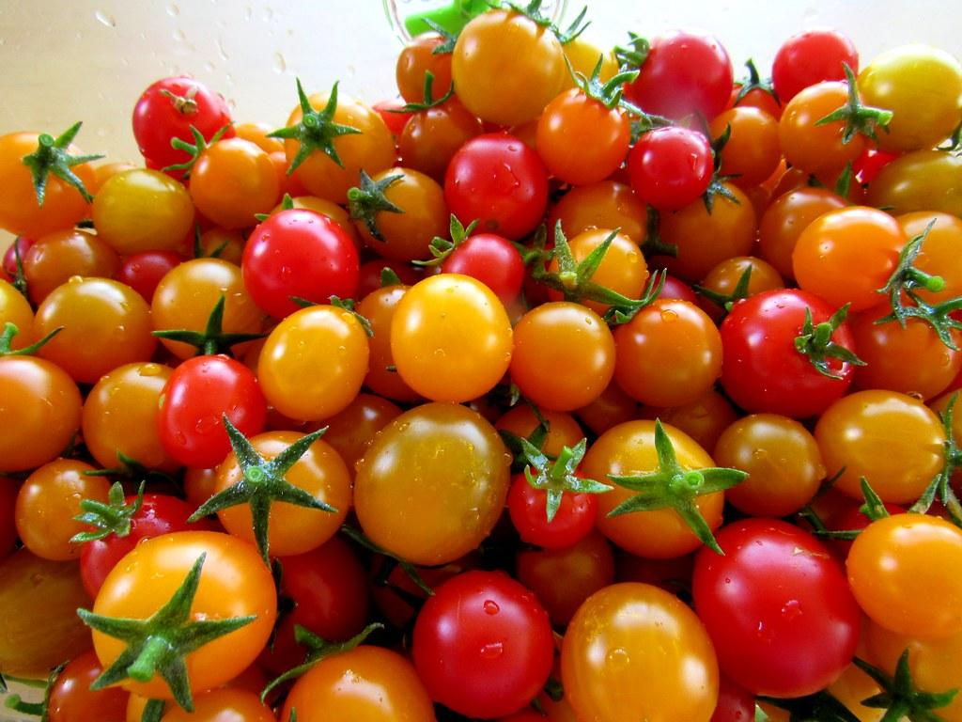
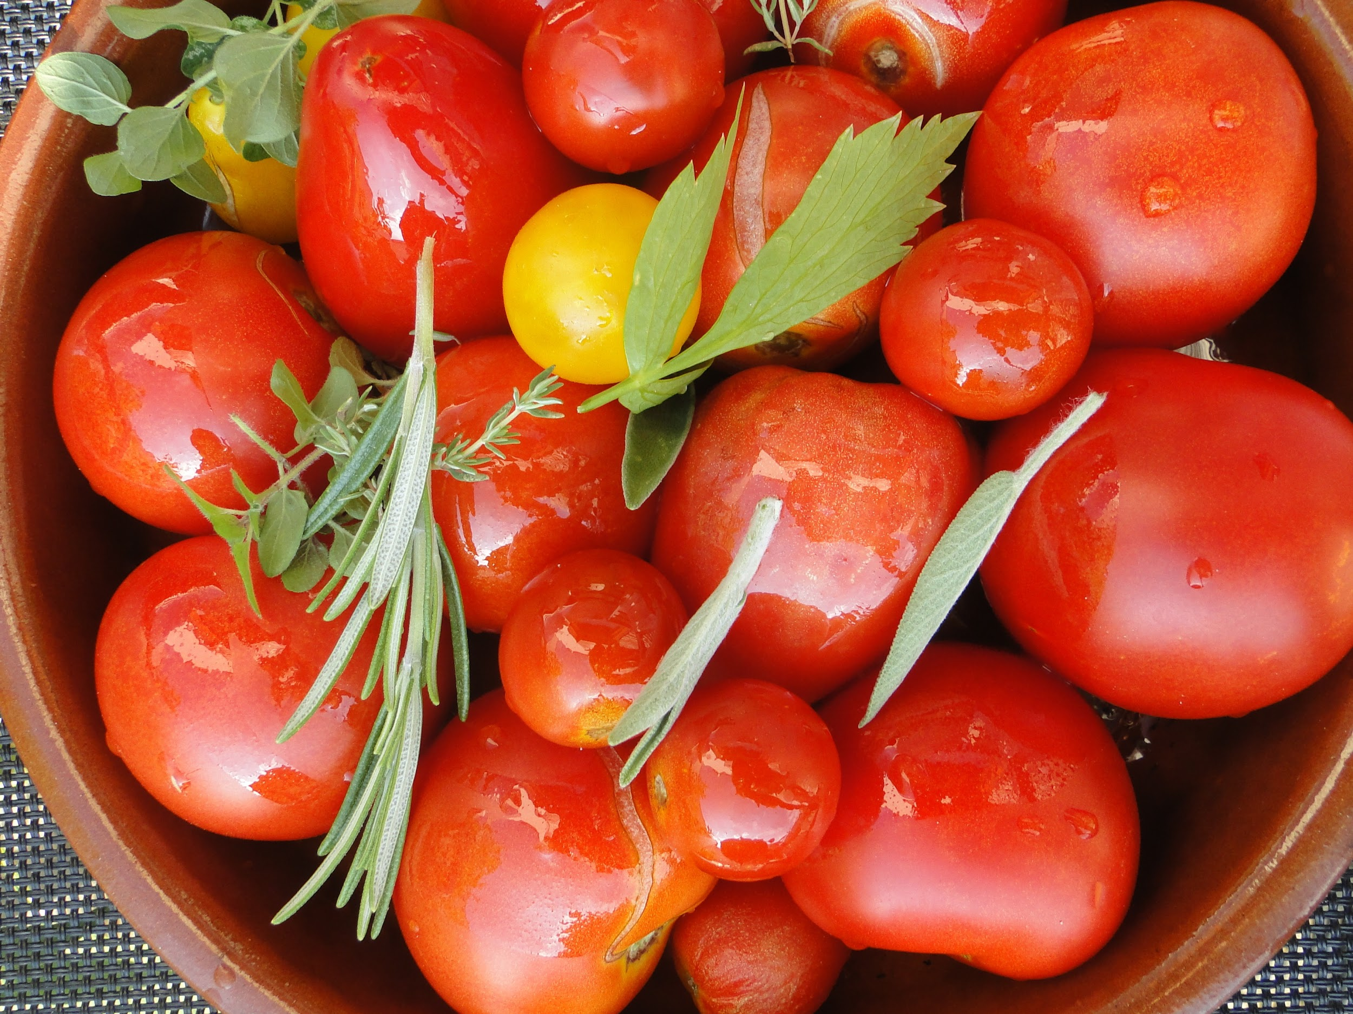
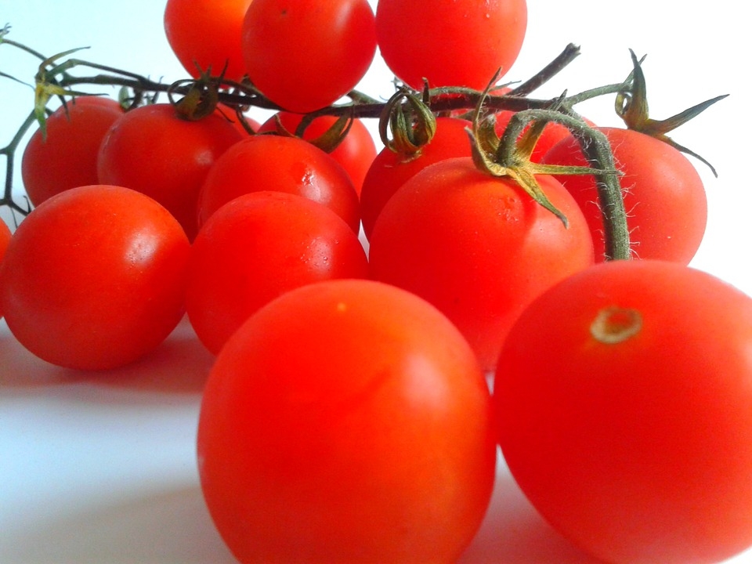
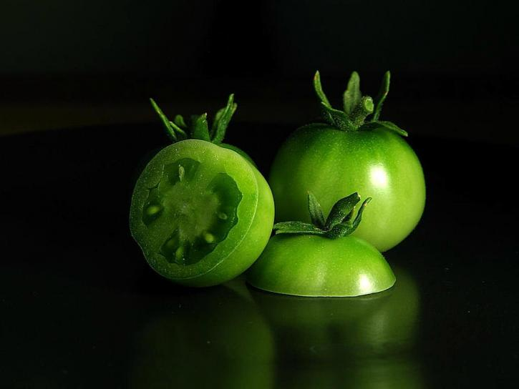
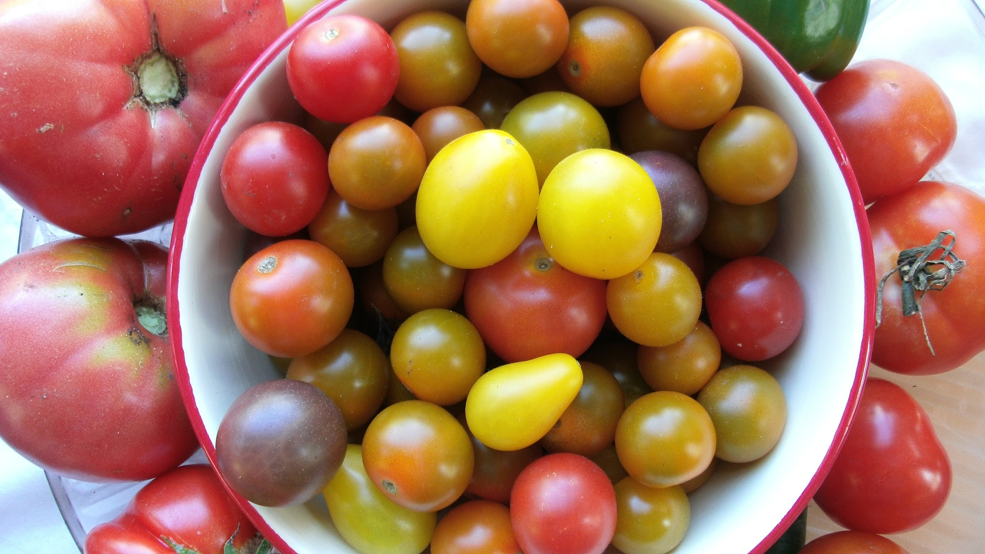
Heirlooms
Slicing
Cherry
Saucey
-PInk Berkeley
-Striped German
-Big Beef
-Cherokee Purple
-Sun Gold
-Black Cherry
-Red Racer
-Sunrise Sauce
Grapes/pears
Cocktail
Green
-Five Star Grape
-Brad’s Atomic
-Sweet Million
-Green Zebra

Slide 6
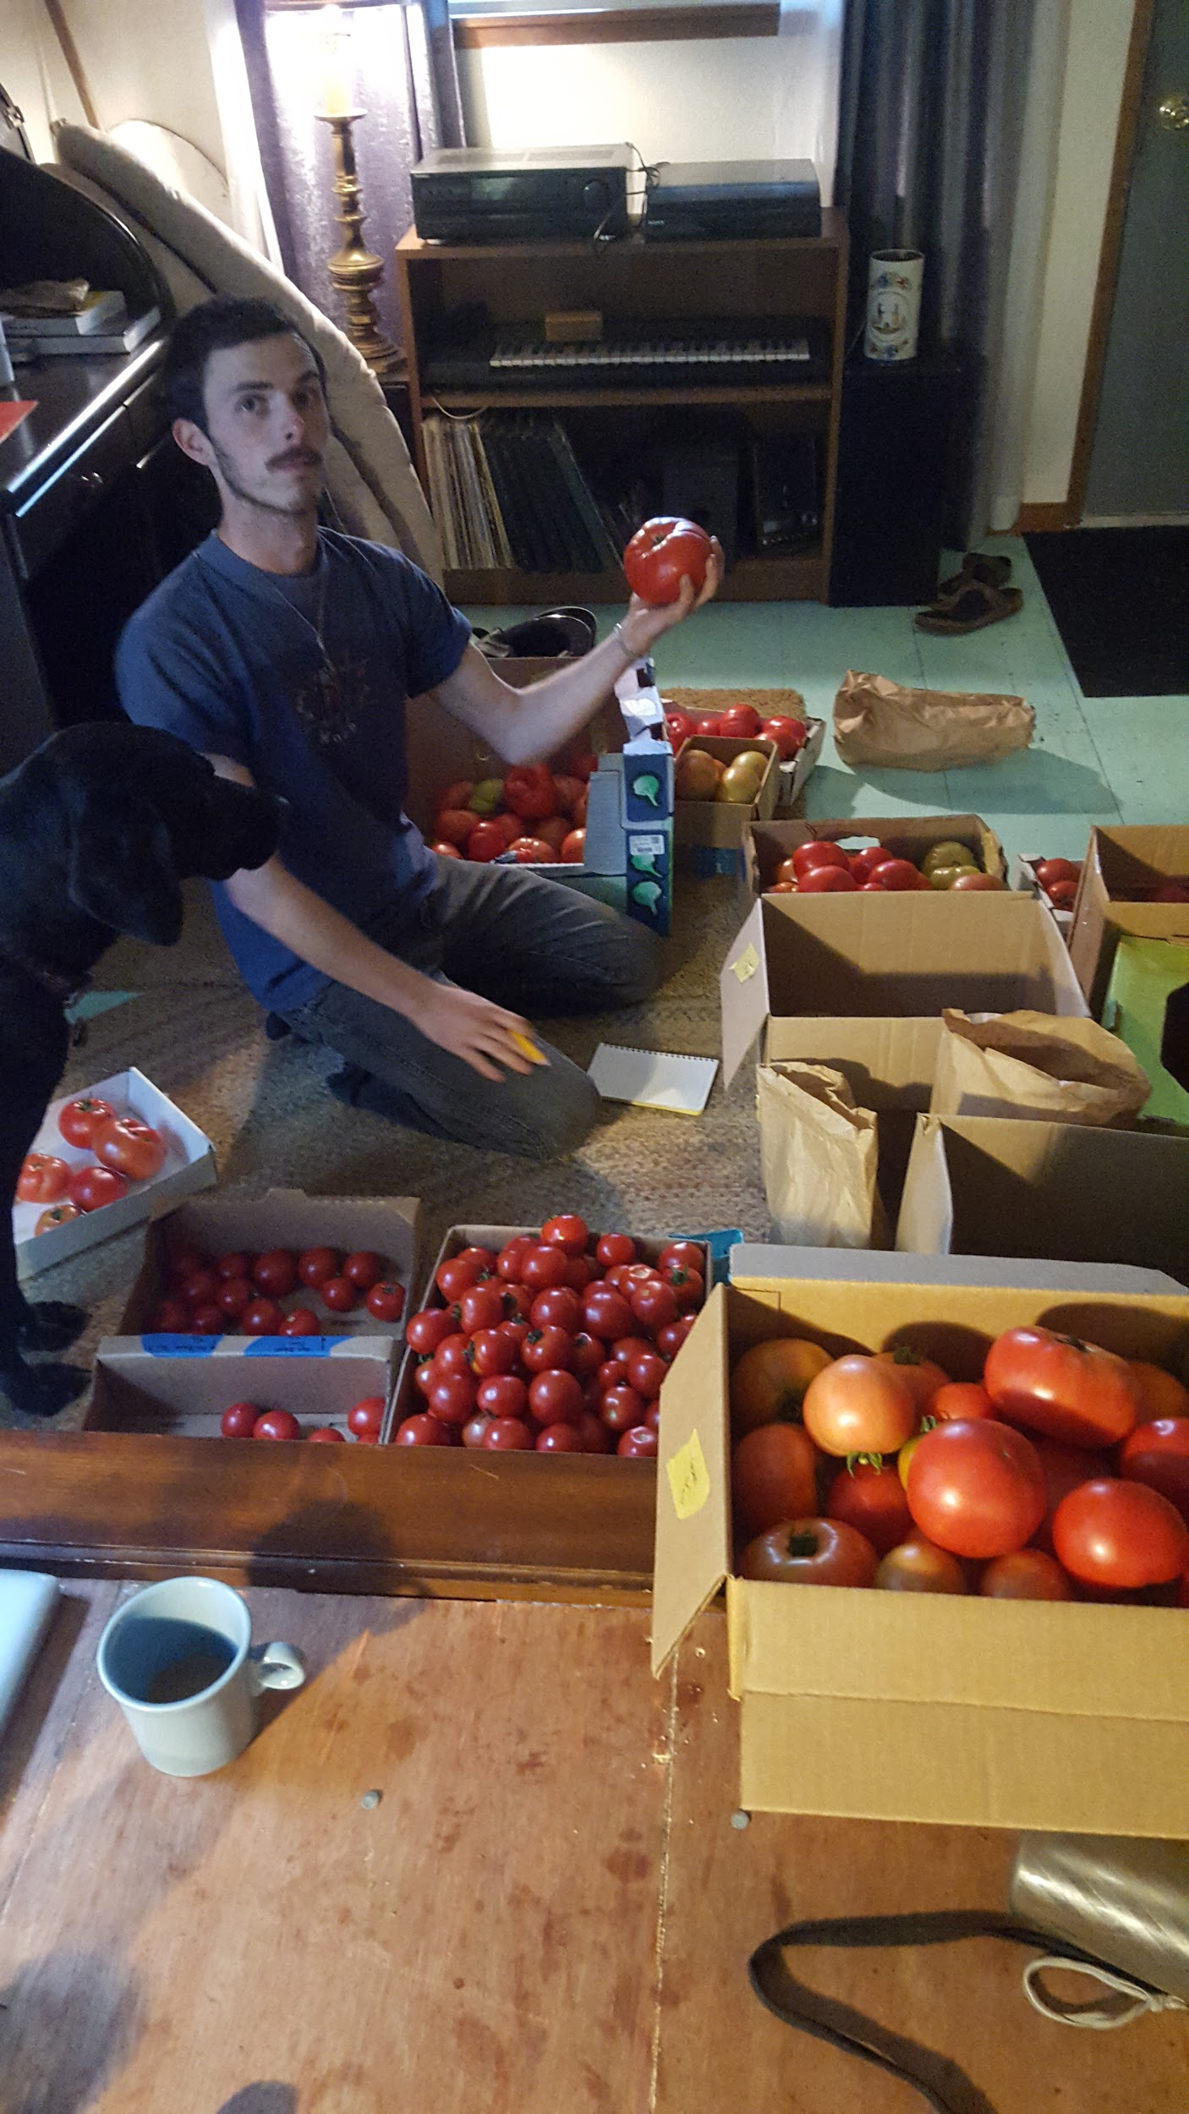
Visual Assessment
We are not looking at marketability but rather the aesthetic presentation of the tomato at hand.
I ask you to, in your own words, describe the color and shape of each variety. Be creative and honest with your description and take note of anything special that you find yourself thinking.
For an aesthetic rating, rate it on the individual tomato and not in reference to the other varieties.

Slide 7
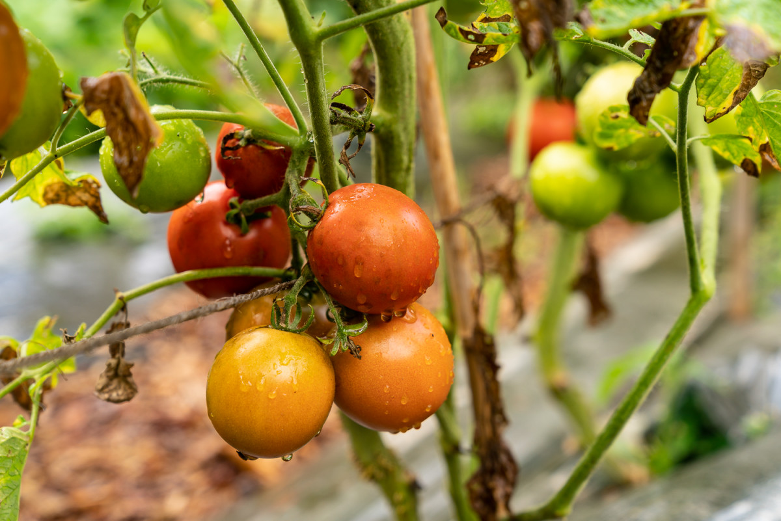
We can use words such as:
Oblong, Pumpkin, Ridged, Peaked, Wrinkly, Soft, Orb, spherical, Creased, Symmetrical, Asymmetrical, Bumpy, Spikey, Flat, Oval, Cylindrical, Football, Intricate, Delicate, Odd, Angular, Concave, Contorted, Curvy, Proportionate, Tapered, Convex, Bulbous
ETC……..

Slide 8
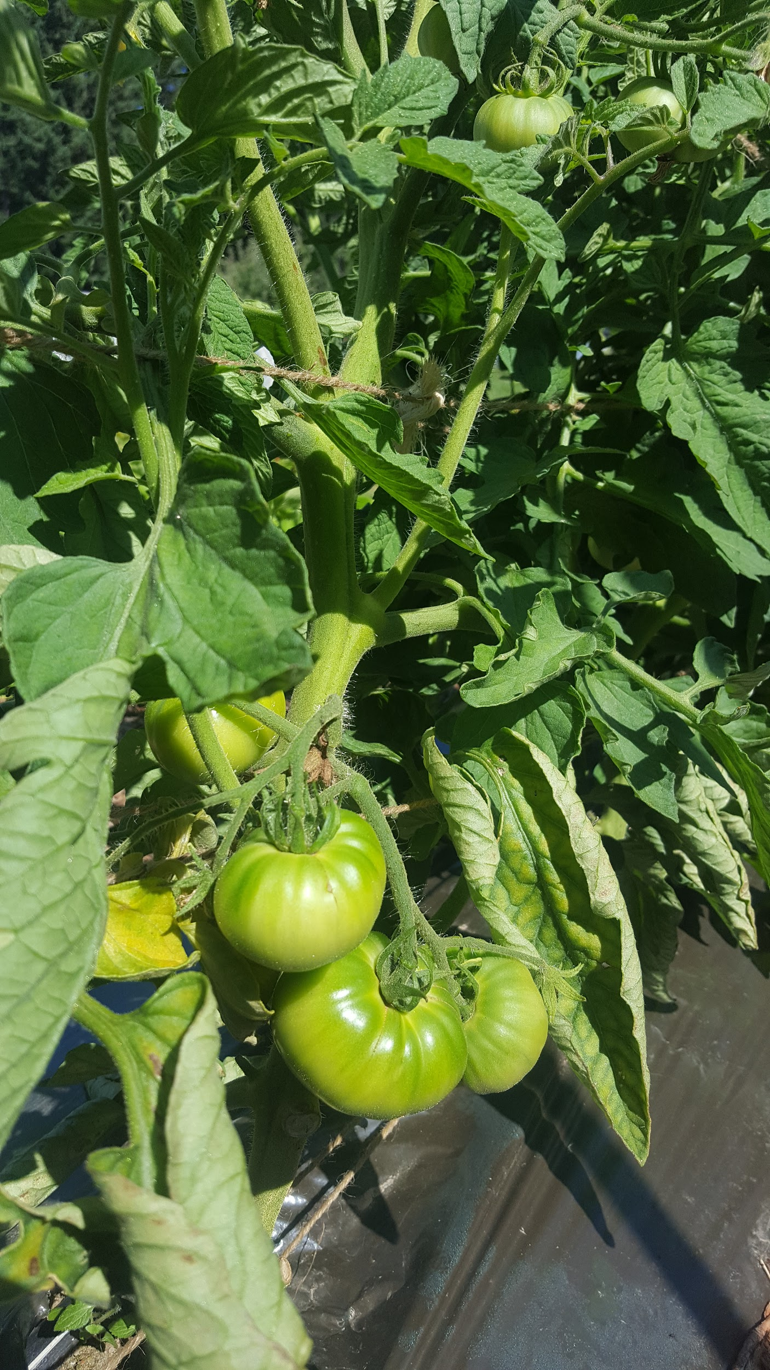
Smelling Assessment
Use that Shnoz of yours: Describe to me the intensity of the smell, low, medium, or high. Is it bland, and low intensity or is it overwhelming and robust.
Then, in your own words, describe to me the profile of the smell…
The rating should be based on the intensity of the individual tomato and not in reference to the other varieties.

Slide 9
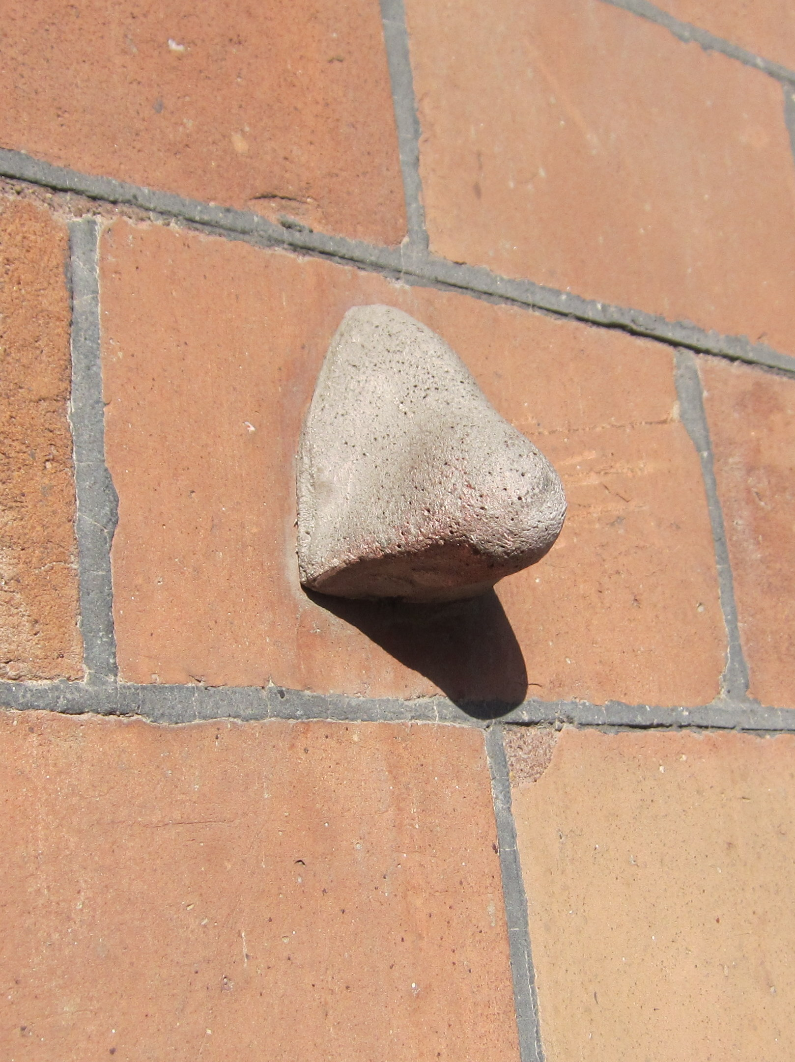
...profile descriptions could be as such:
Rich, Dank, Sour, Skunky, Herbal, Floral, Sweet, Musty, Pungent, Biting, Clean, Dirty, Wet, Earthy, Stale, Spicy, Minty, Fruity, Coffee,
Pleasant, Fishy, Soapy

Slide 10
Tasting Assessment:
FINALLY! we can taste them…
I need you all taste the tomato and pay attention to the acidity, sweetest and texture, as well as the skin thickness of each variety. It may be necessary to take multiple tastes to get it clear. Texture can be described as firm, watery, mealy, seedy, etc.
A very important aspect of the taste is the particular profile that each tomato has; in your own words please describe what flavors you are getting from each individual tomato.
It may be necessary to cleanse your palate after an especially robust tomato bite, please feel free...

Slide 11
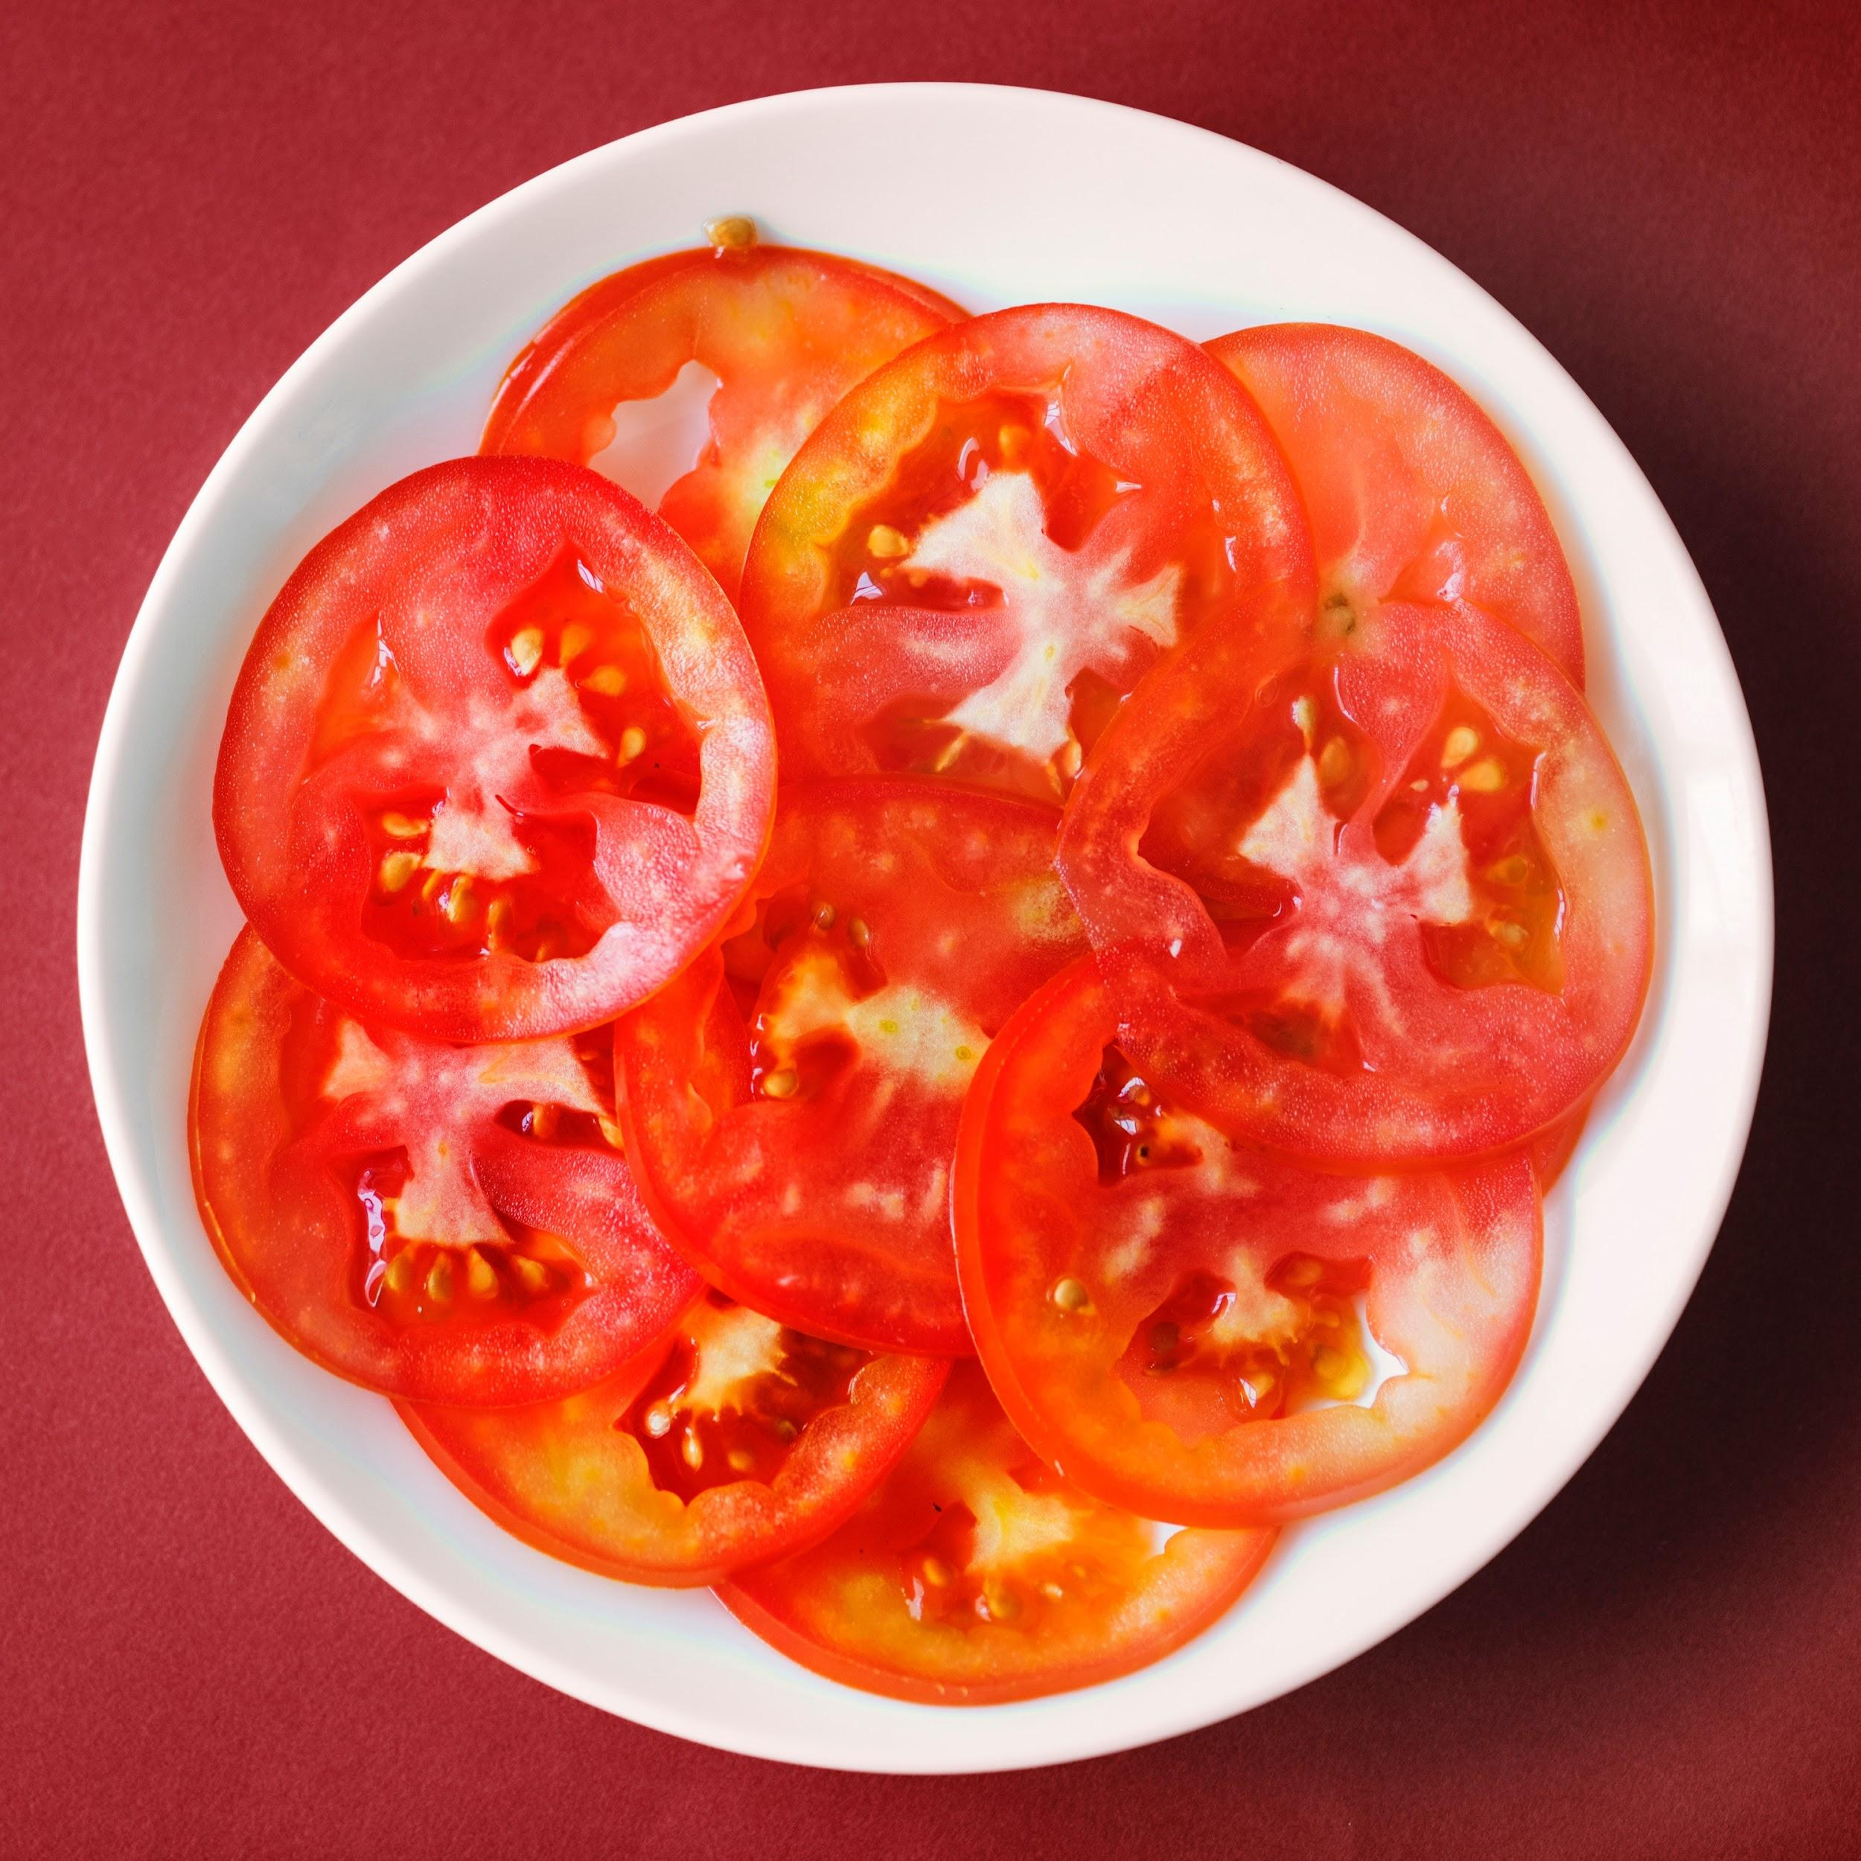
Tomato profiles can be described as….
Spicey, Earthy, Sweet, Tangy, Dirty, Flowery, Harsh, Nutty, Milky, Metallic, Sour, Meaty, Alcohol, Refreshing, Bland, Boring, Funky, Odd, Simple, Silky, Flavor-less, Burnt, Tobacco, Caramel, Spiced, Rose-y, Bitter, Botanical, Woody, Waxy
Be CREATIVE ...but truthful

Slide 12
Discussion??

