Slide 1
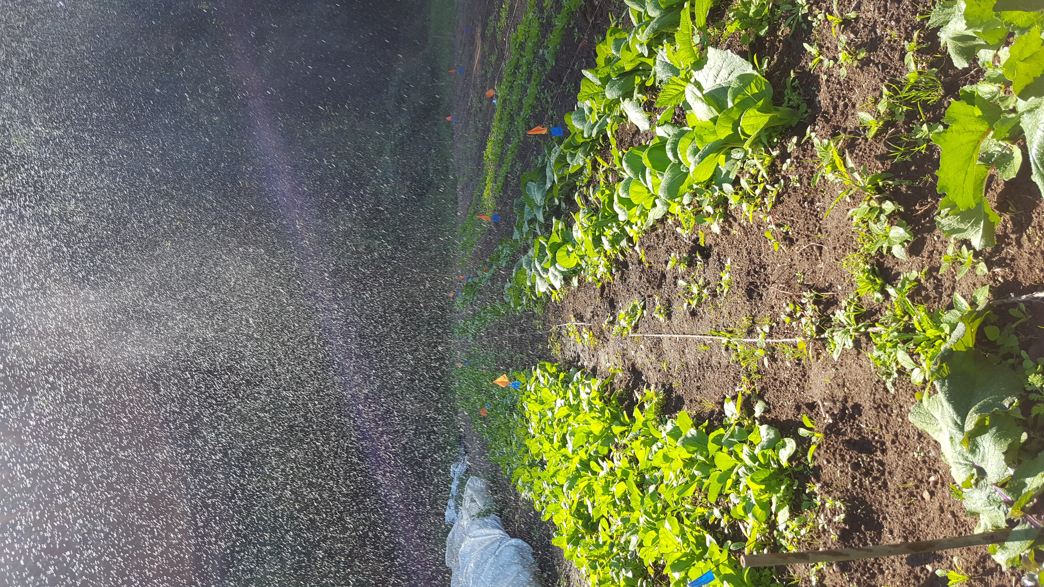
Daikon and Arugula Tasting!
Photo by Caleb Poppe
Caleb Poppe
Evergreen State College
2020

Slide 2
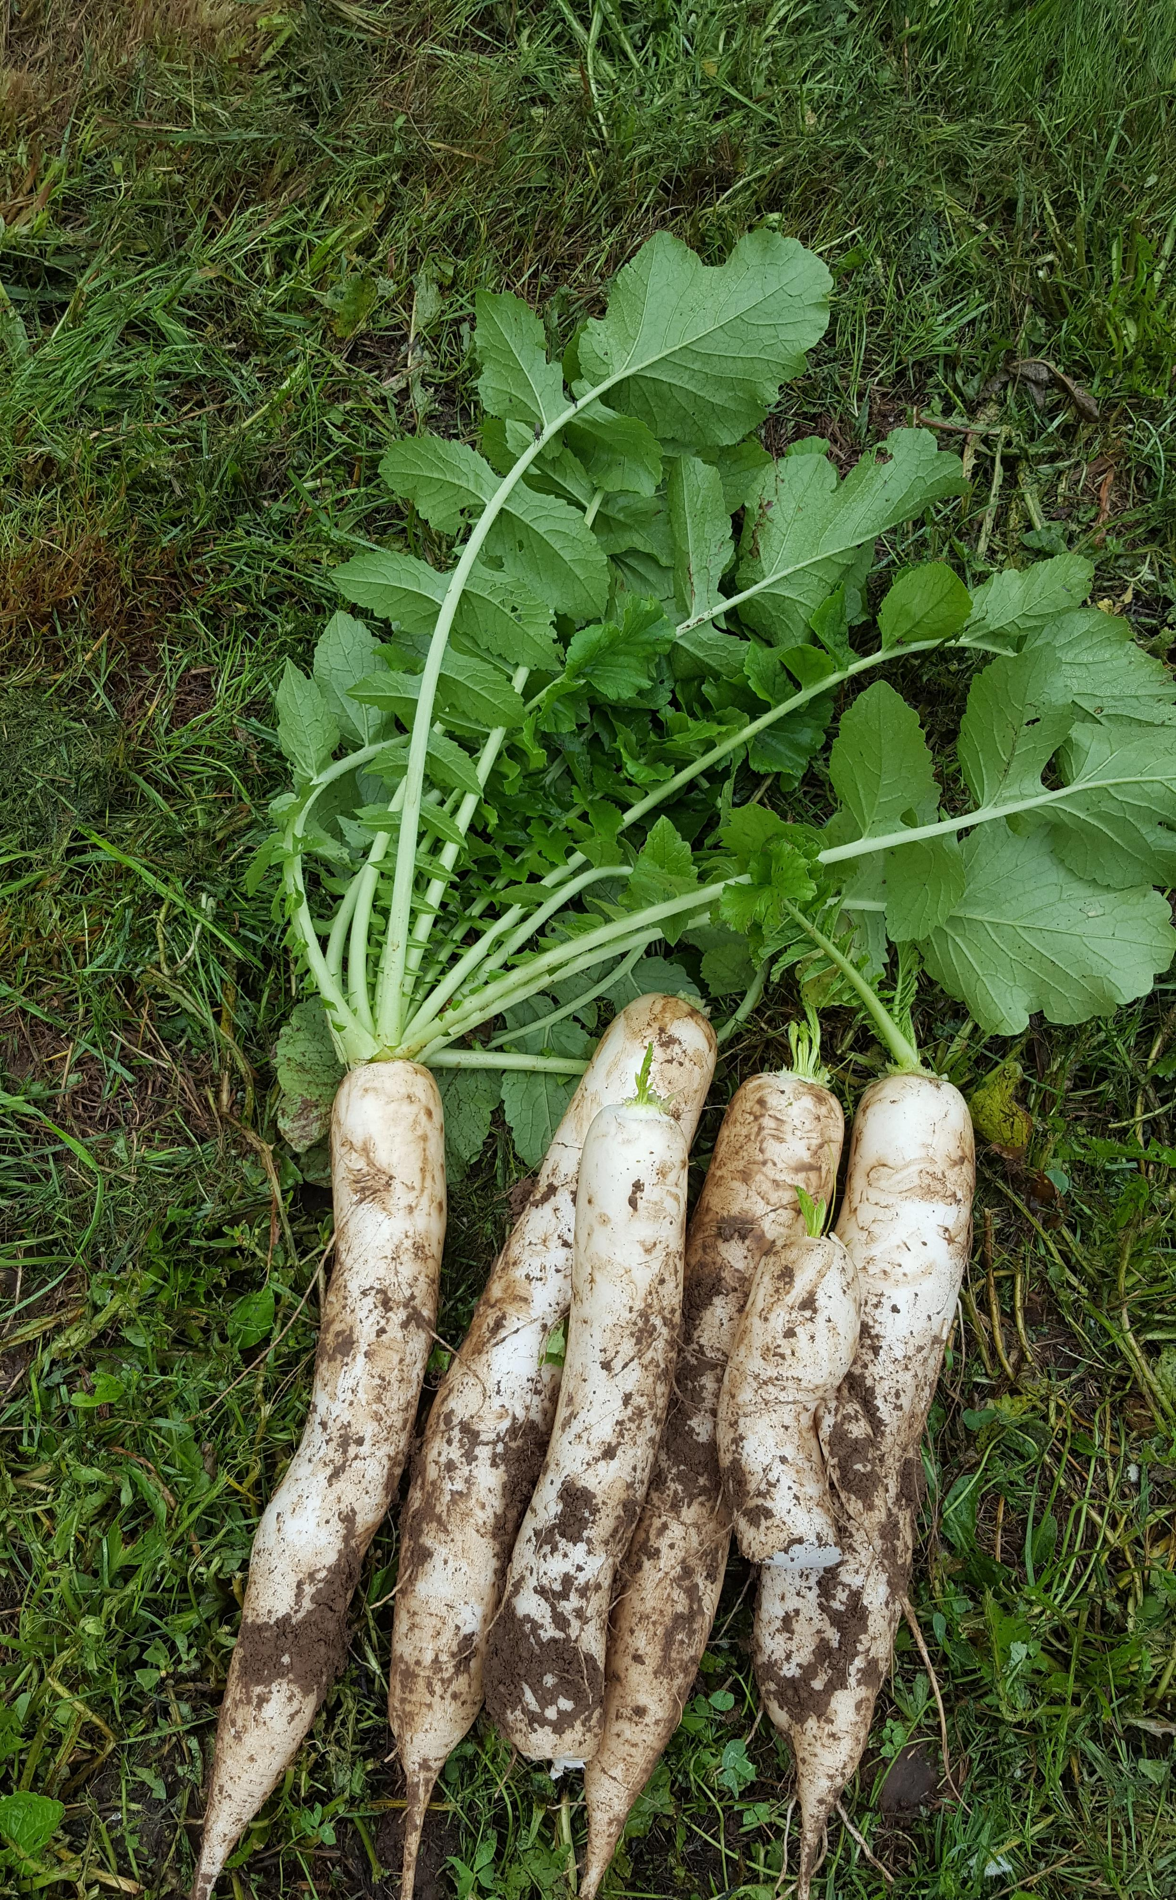
What the heck is Daikon radish?
A member of the Brassica family, Raphanus sativus var. Longipinnatus
Different from the classic ‘round red’ radish that is popular in western cultures, daikon are classically long, wide and white – baring similarities to a large parsnip.
Recent breeding efforts have brought forth varieties in color, shape and flavor!
Photo by Caleb Poppe

Slide 3
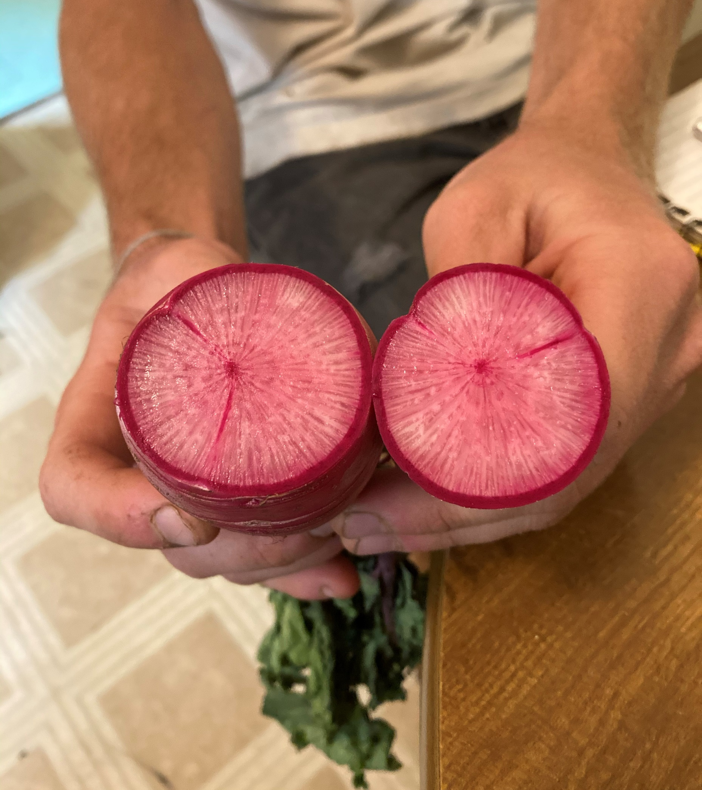
Daikon History
The Radish is believed to have originated in the Mediterranean, near the Black Sea – 4000 years ago
Said to have arrived in Japan in nearly 1400 years ago
Currently most cultivated vegetable in Japan
(Sunset Western Garden, 2012)
Photo by Caleb Poppe

Slide 4
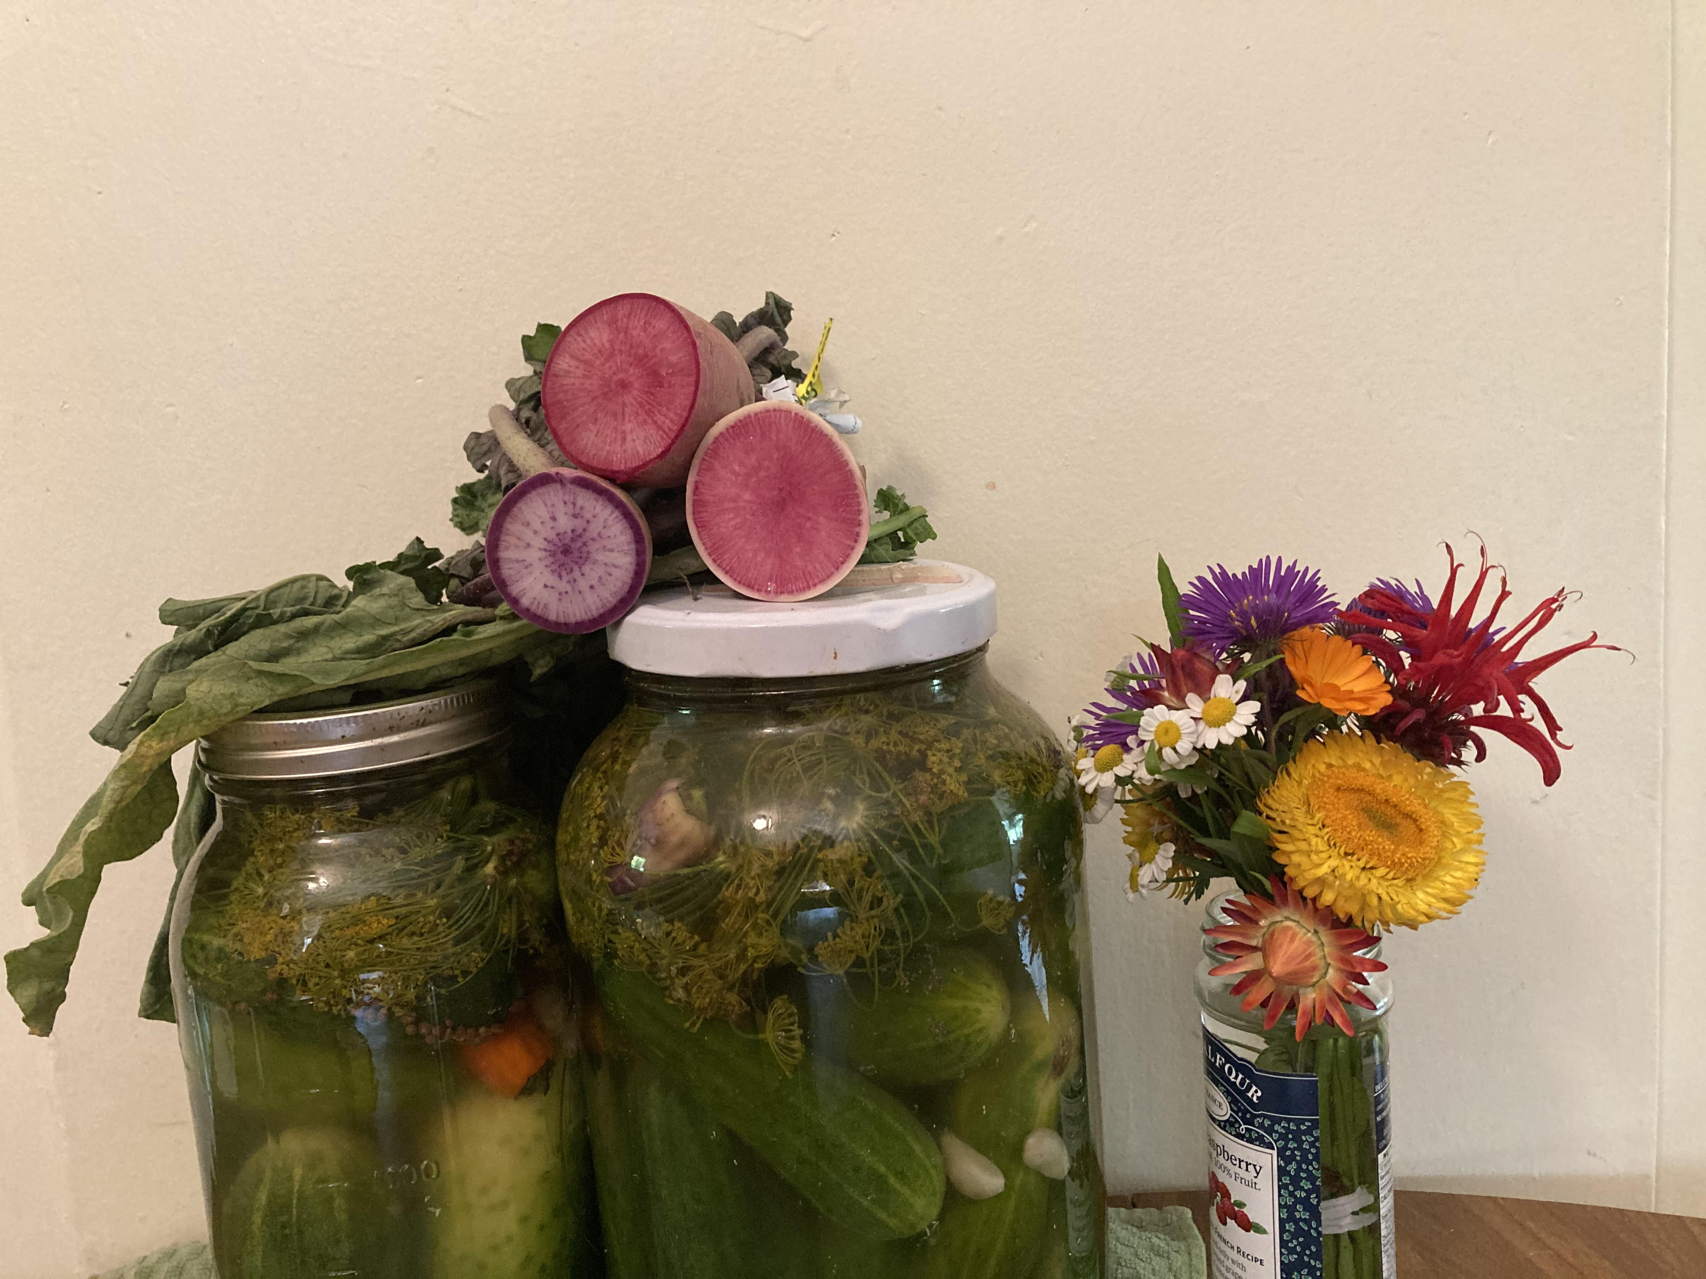
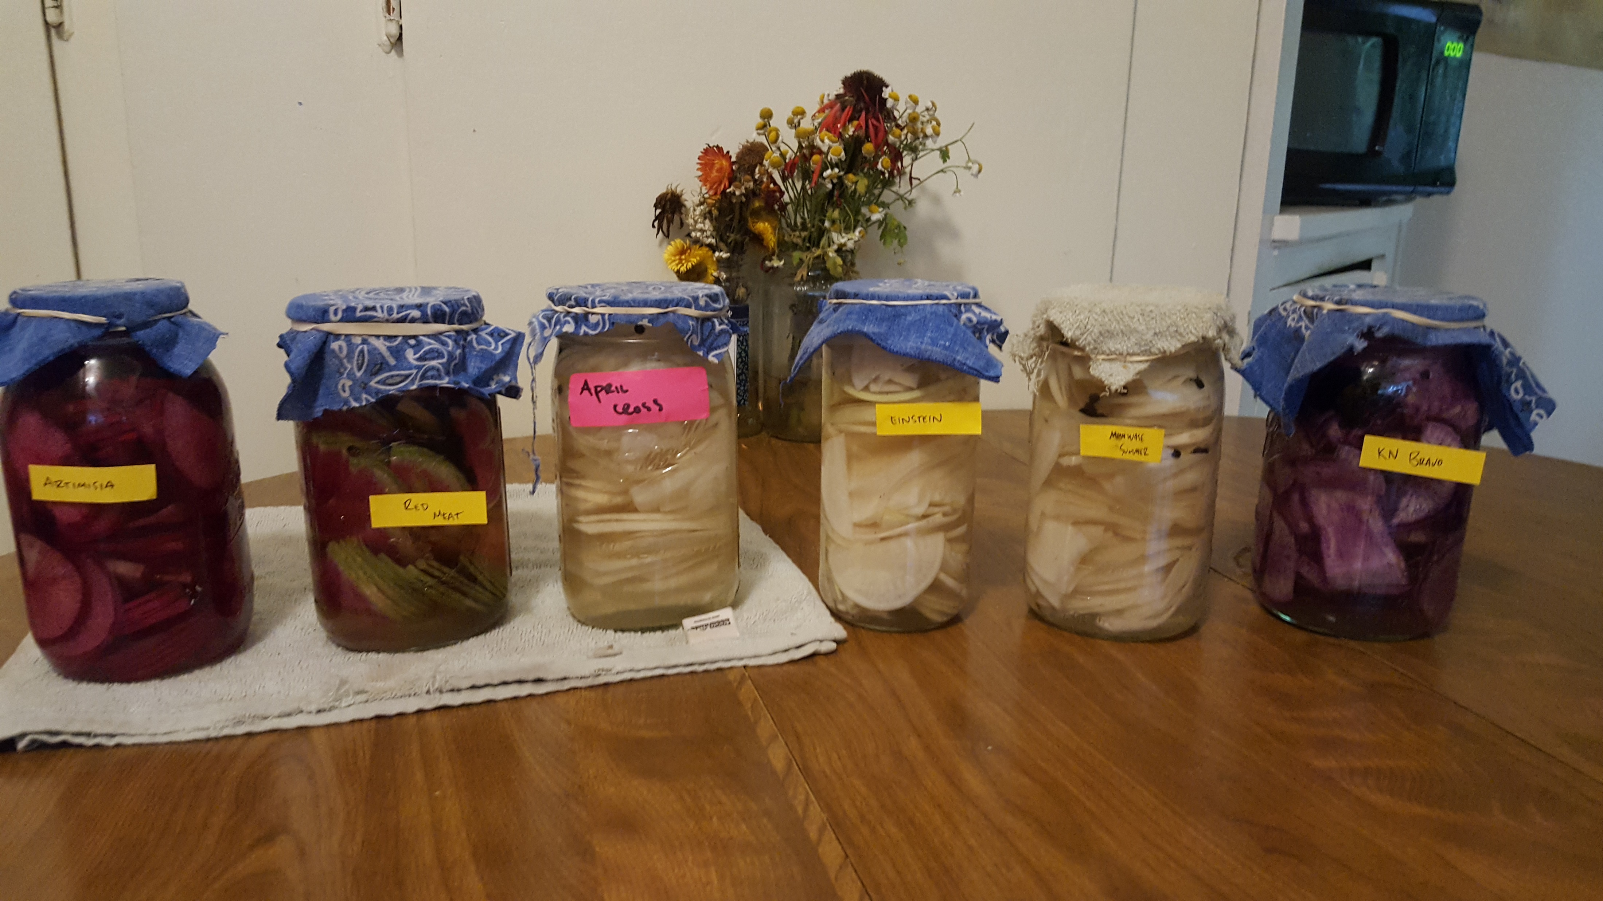
Common Uses
Ideal Growing Conditions
In Japan, Daikon is commonly added as a raw, grated garnish to many meals.
Very commonly Daikon is pickled and sundried, to be added to many rice dishes as a meal compliment
Chinese herbalist are known to dry daikon to be added to herbal teas to aid in digestion and upset stomachs.
Rich and evenly moist soil with full sun/partial shade (in summer)
Prefer milder temperatures, direct seed anytime before high summer temperatures arrive.
In hot temps, radishes can be bitter and go to seed
Approx. 20 DTM.
(Sunset Western Garden, 2012)
Photo by Caleb Poppe

Slide 5
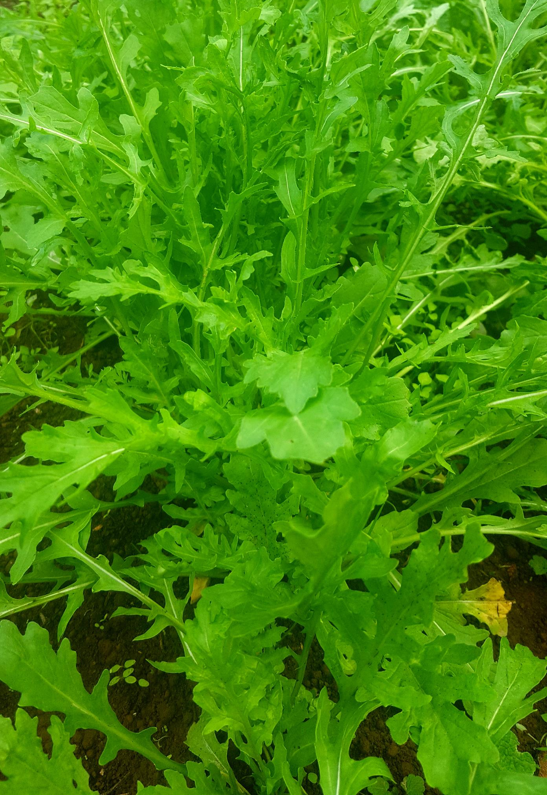
Why Arugula?
Arugula (Eruca vesicaria) is a popular leafy green that can bring some pizazz to any green salad.
This crop enjoys colder temperatures and can be seeded in late Winter and well into the Spring, then again in the Fall.
A ‘chef’s favorite’ and great cash crop that is easy to grow.
Photo by Caleb Poppe

Slide 6
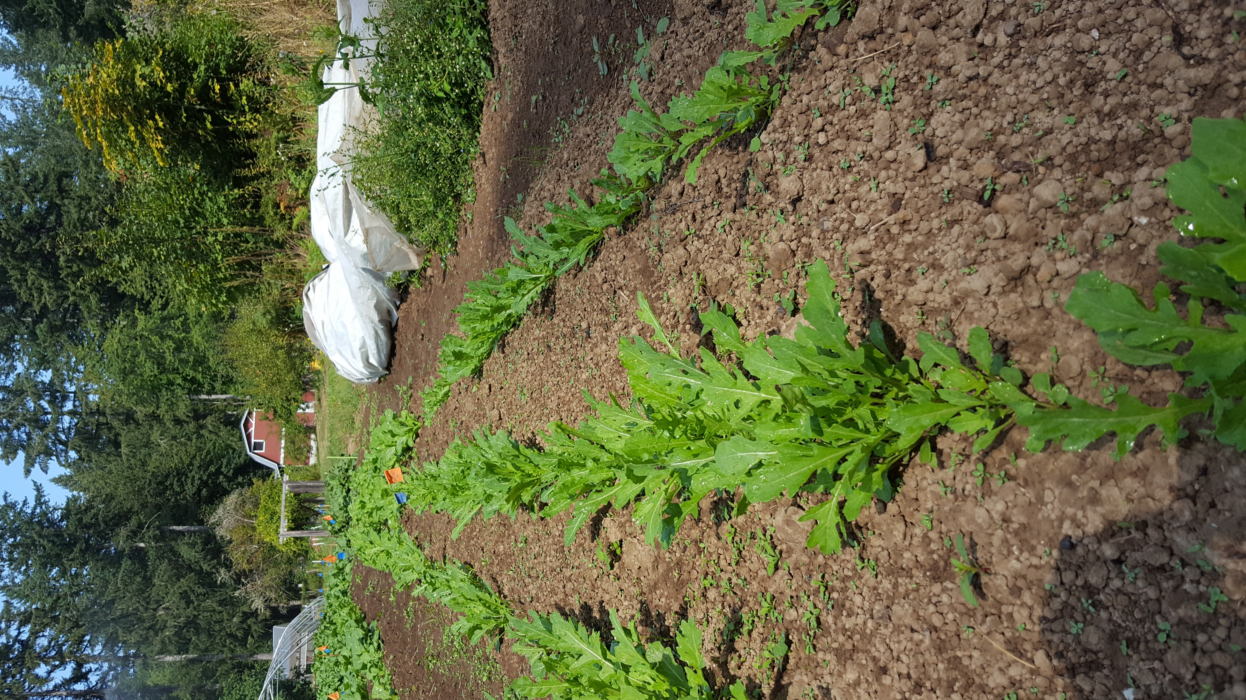
Common uses
Aside from its popularity as a salad green, the sharp flavor of arugula can bring some zest to a lot of different recipes.
I have always enjoyed adding arugula to pesto recipes, either in addition to, or in lieu of basil.
Older, more rigid arugula leaves are a great addition to starchy soup recipes, either pureed or whole leaf.

