Slide 1
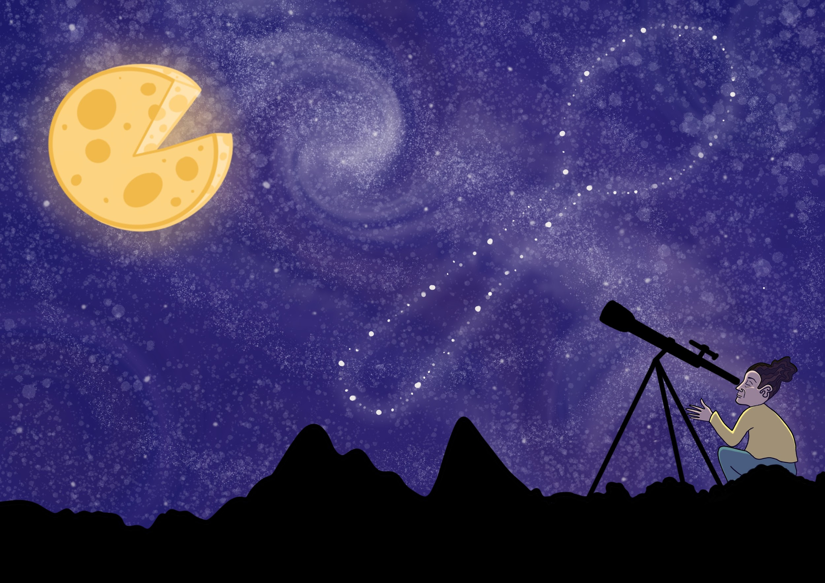
Eating with my Eyes
by Eligh Kindall

Slide 2

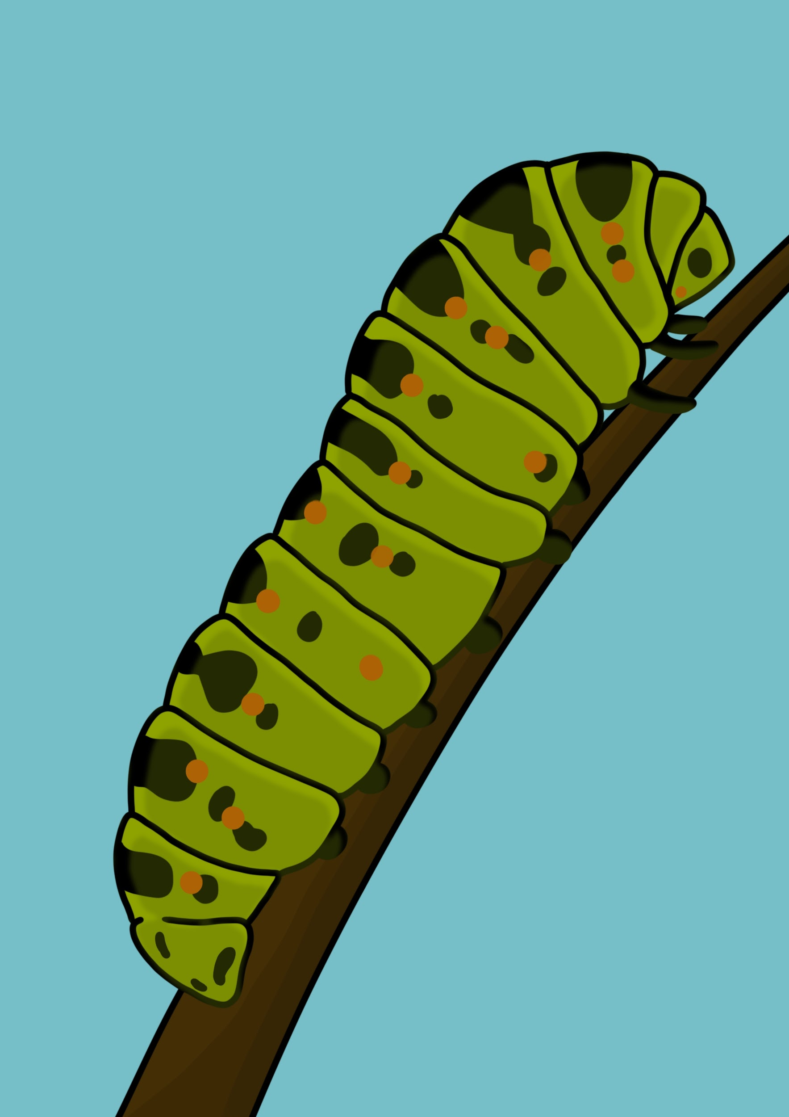
Eating in Isolation
“If you want a real
encounter with another
culture, you have to
abandon your cocoon”
(Dunlop, 2008, p. 152).

Slide 3
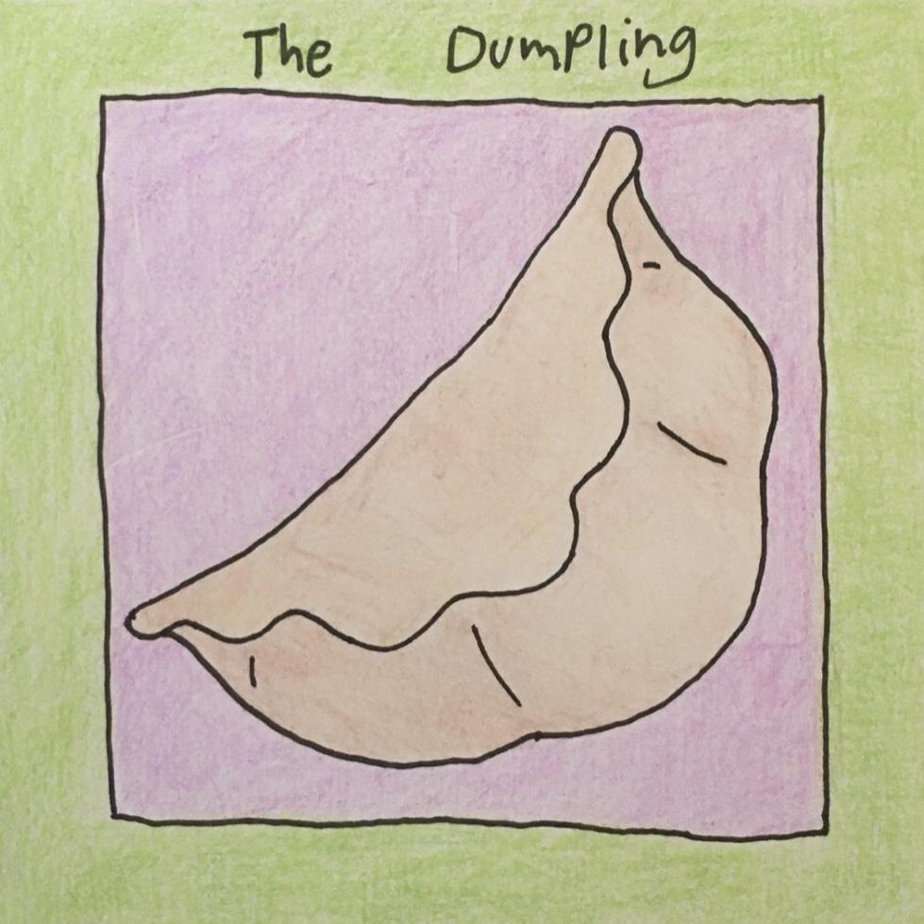
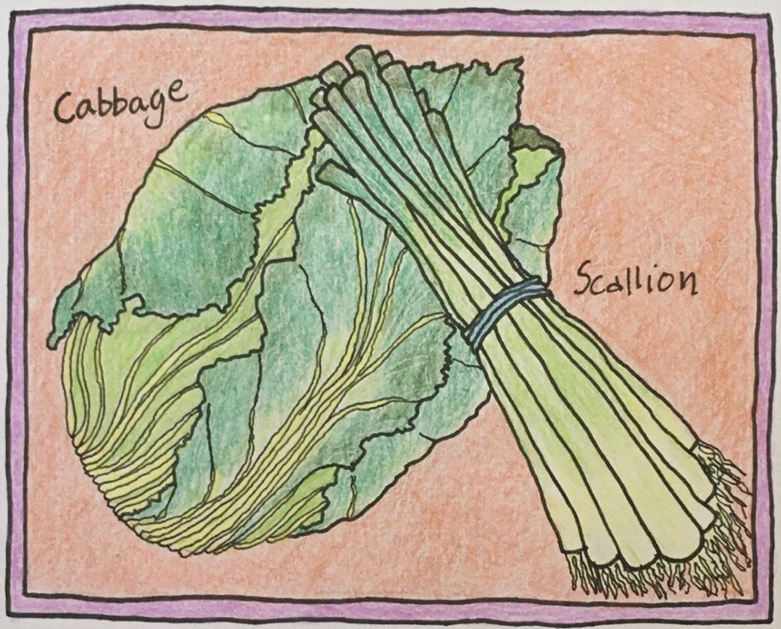
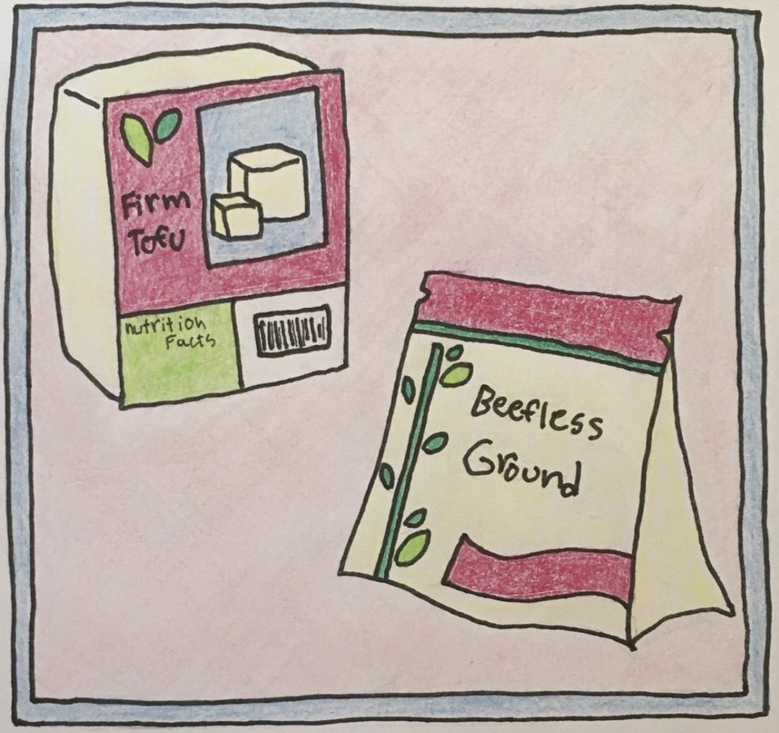
Week 4

Slide 4
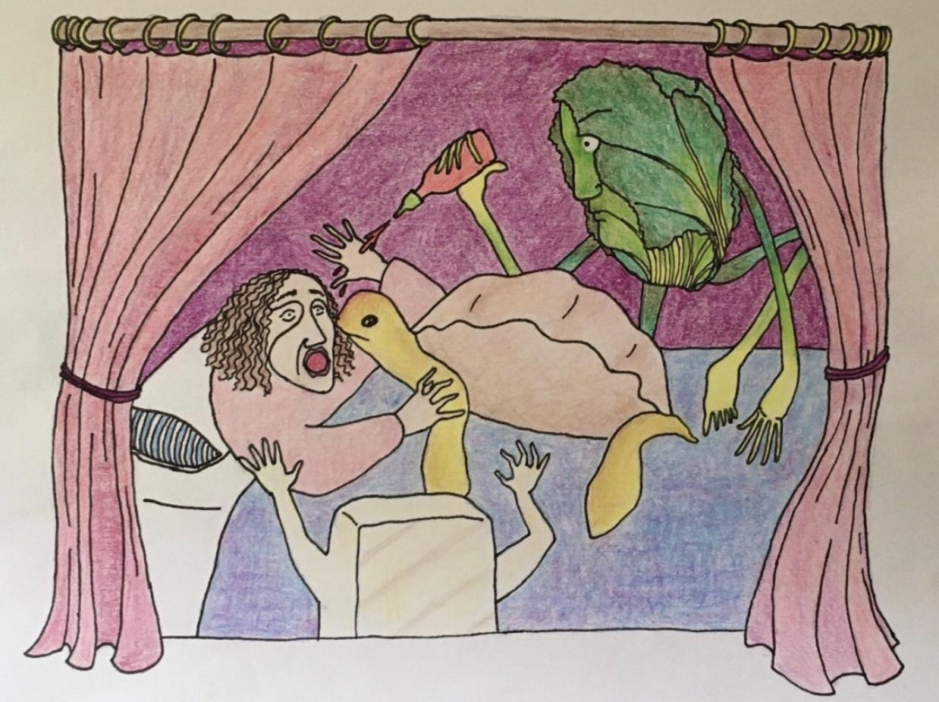

Slide 5
Painting Pictures With Words
“The shot opens on a freeway outside of Portland State University on a sunny summer day. A city bus drives by under the shade of a green tree. It is the perfect image to represent the flourishing development of a community: well functioning infrastructure, city assistance, a space of education, well lit by the summer sun against a fervid backdrop of plant life. The narration fades in saying, “today the area is full of new developments, including Portland State University, and divided by a freeway, but it was once a colorful immigrant neighborhood” (Horton). As this is said, the image begins to fade out, revealing a black and white photo of the same place from long ago. South Portland, it is revealed, was full of immigrants (mostly Jewish and Italian) and their businesses. A montage of old images follows, depicting families, stores, street fonts, and people hard at work. It is crazy to see the same place at two different points in time, and really puts into perspective where things began.”

Slide 6
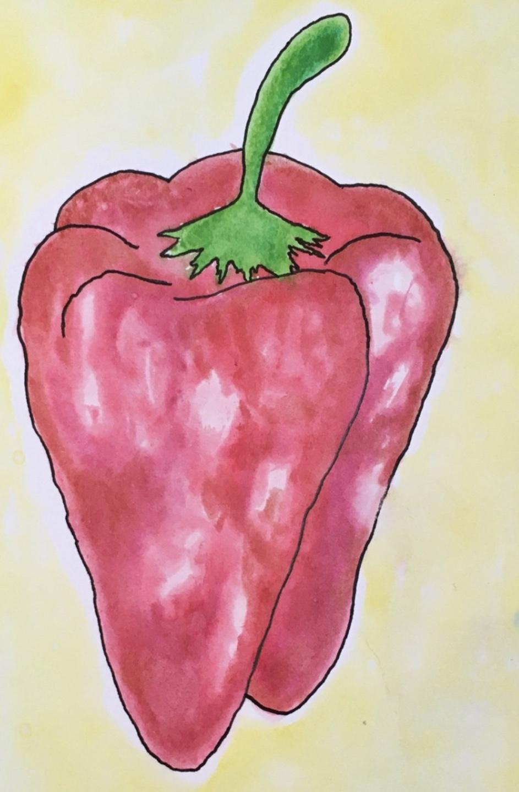
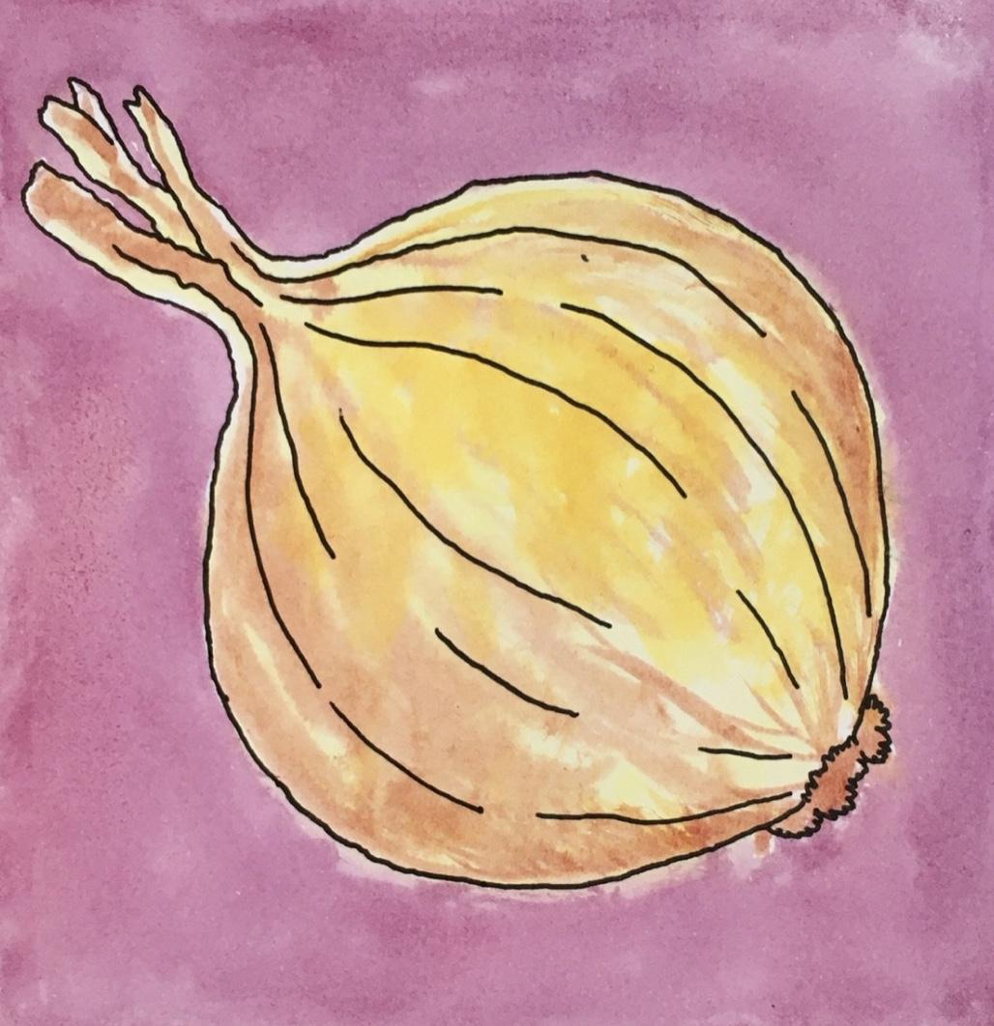
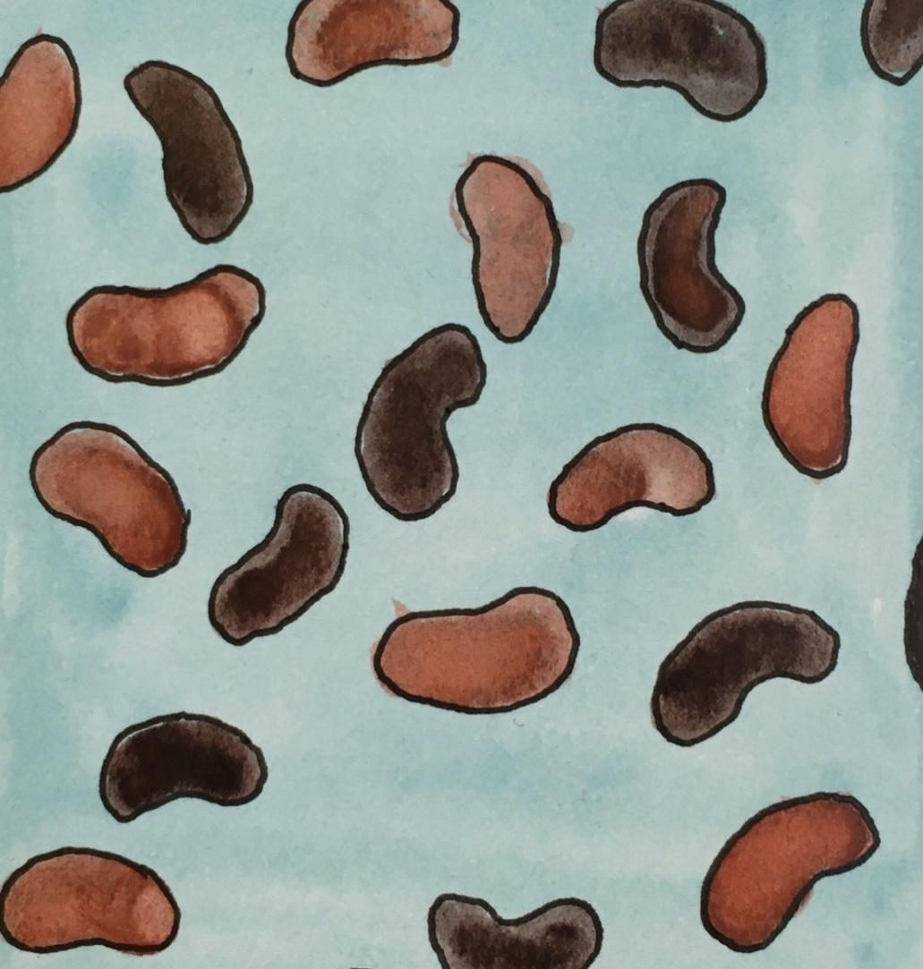
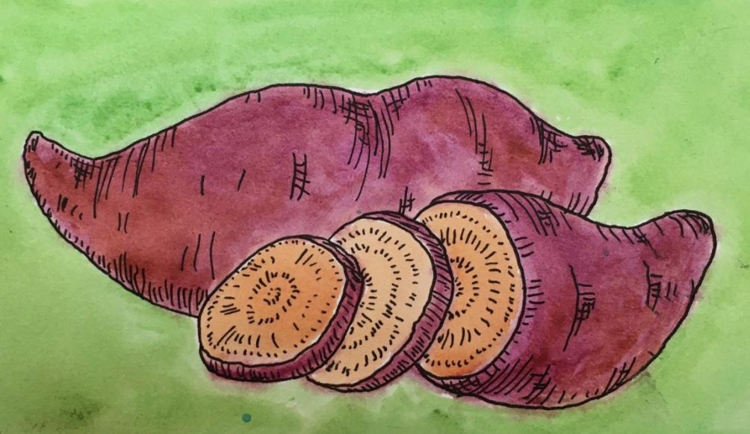
Week 5

Slide 7
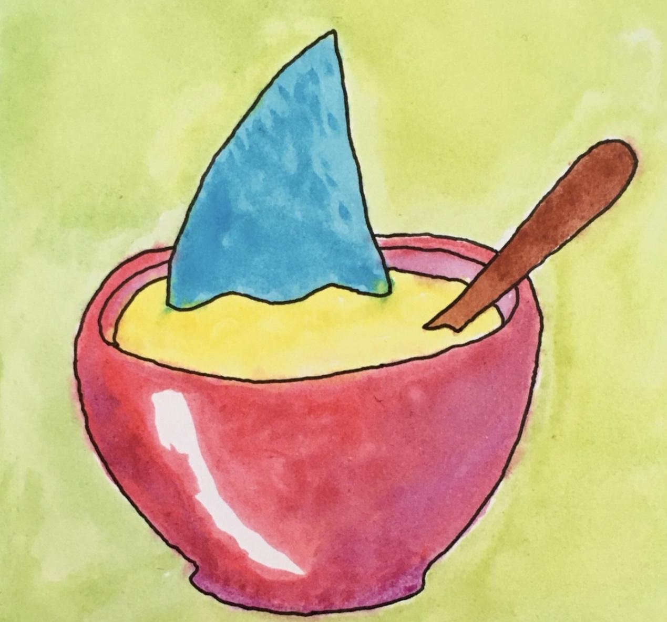
“People want to eat delicacies like shark’s fin just because they are rare and expensive, and because they are the kind of thing emperors used to eat” (Dunlop, 2008, p. 262)!

Slide 8
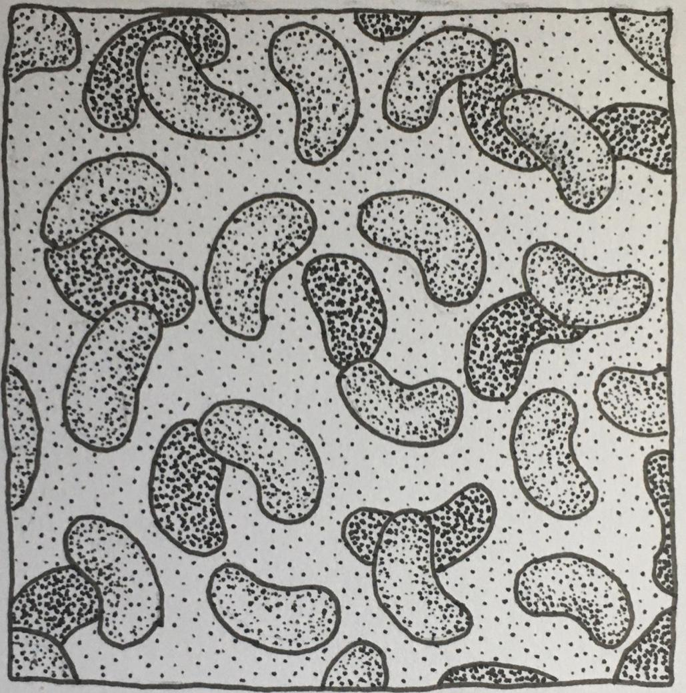
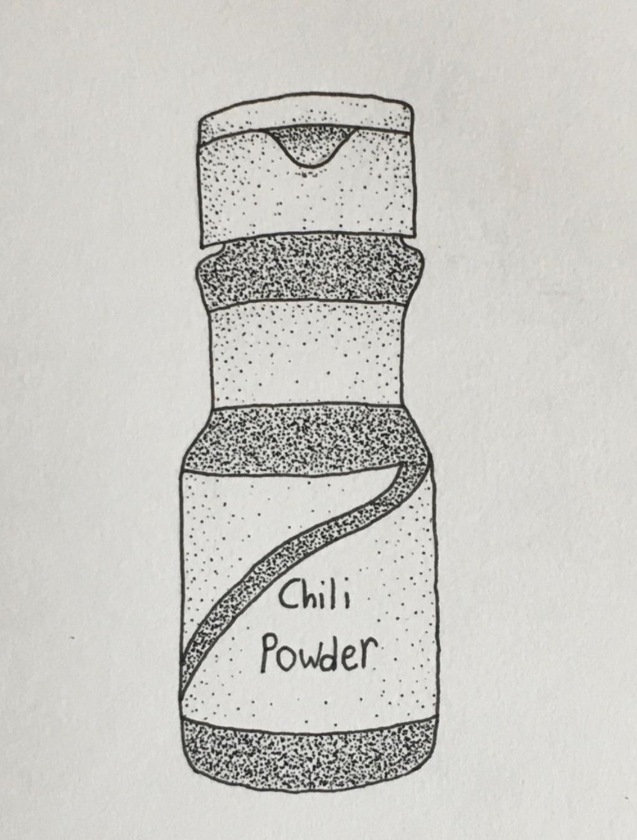
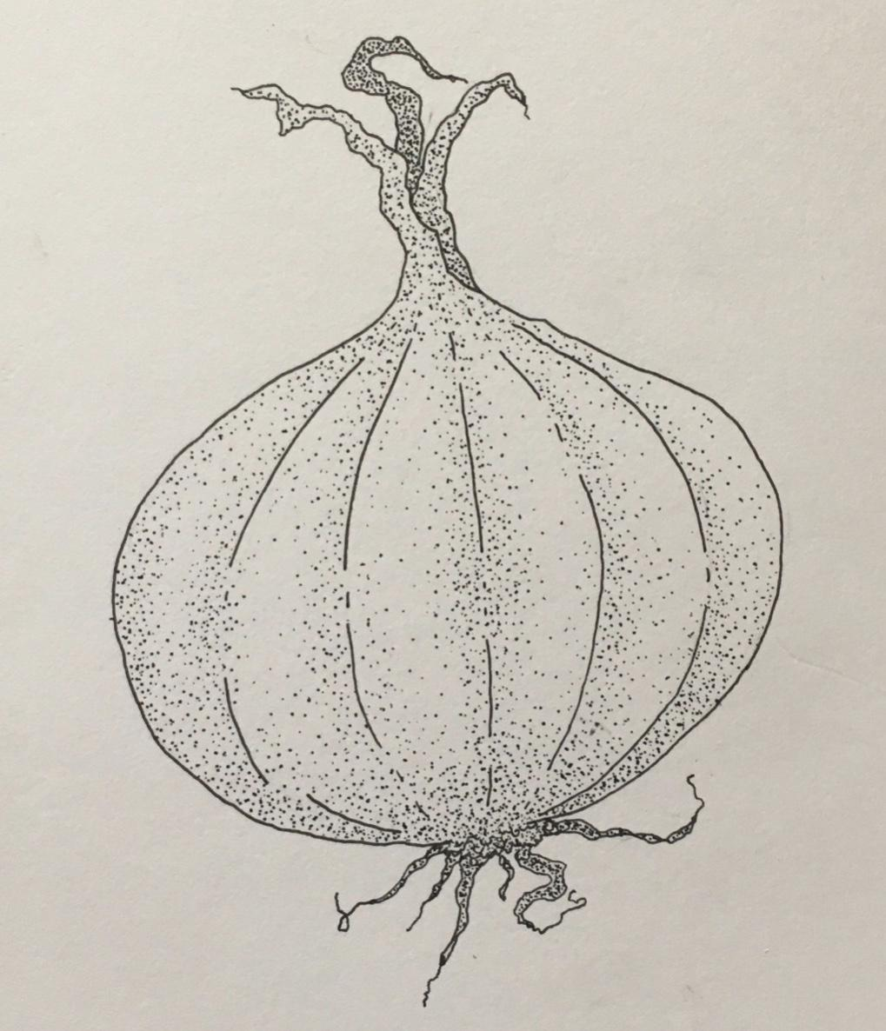
Week 6

Slide 9

“Food insecurity is a characteristic of our food system, one that has been amplified, not created by the COVID pandemic” (Williams).

Slide 10
Pandemic Academy
“context is all because you can’t understand what you’re looking at without grasping the circumstances within which it takes place, which you can’t see with your eyes. Understanding doesn’t always come to us through our eyes. Likewise, COVID-19 has produced a context which makes the familiar strange. ” (Koppelman).

Slide 11

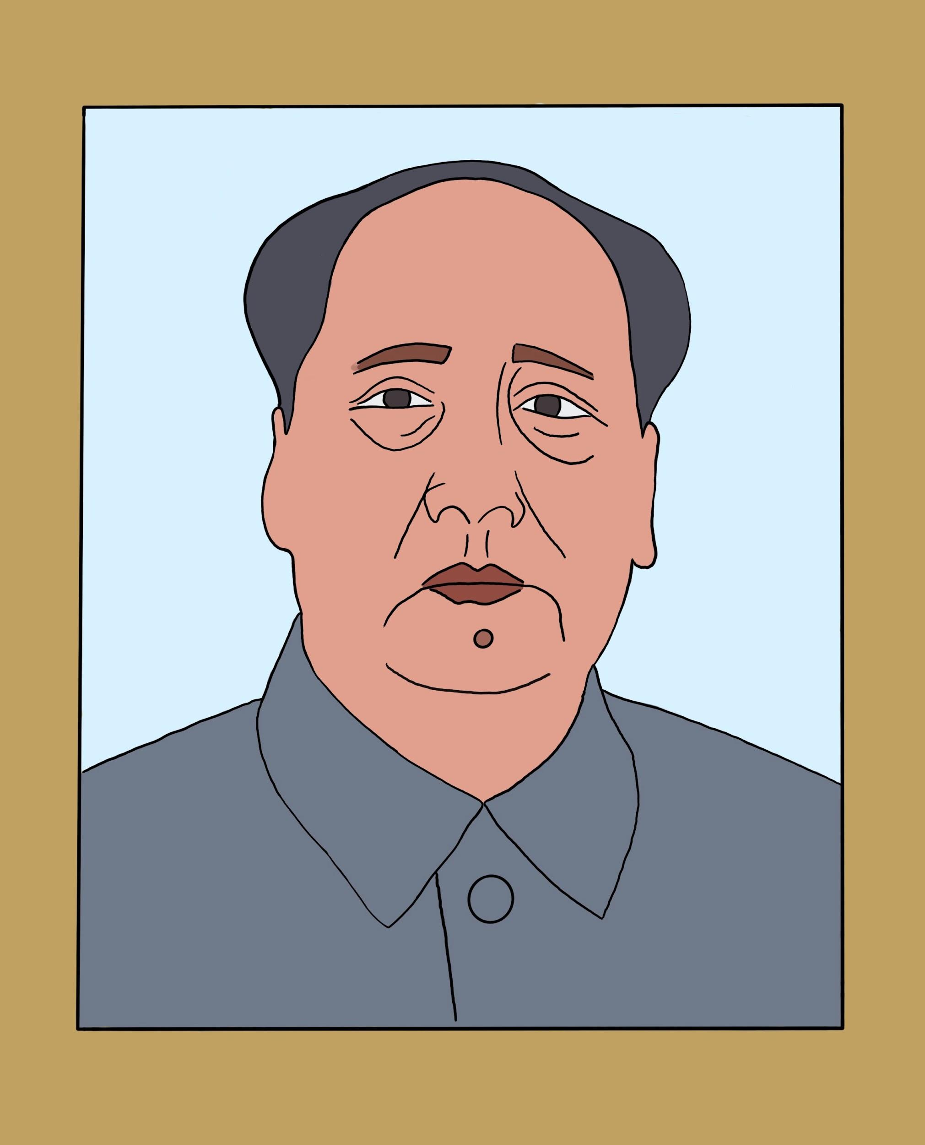
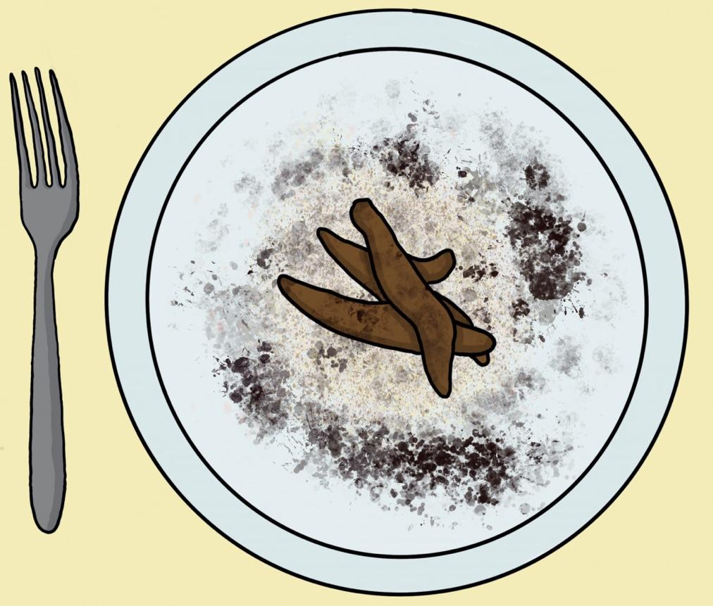
Weeks 1 and 2

Slide 12
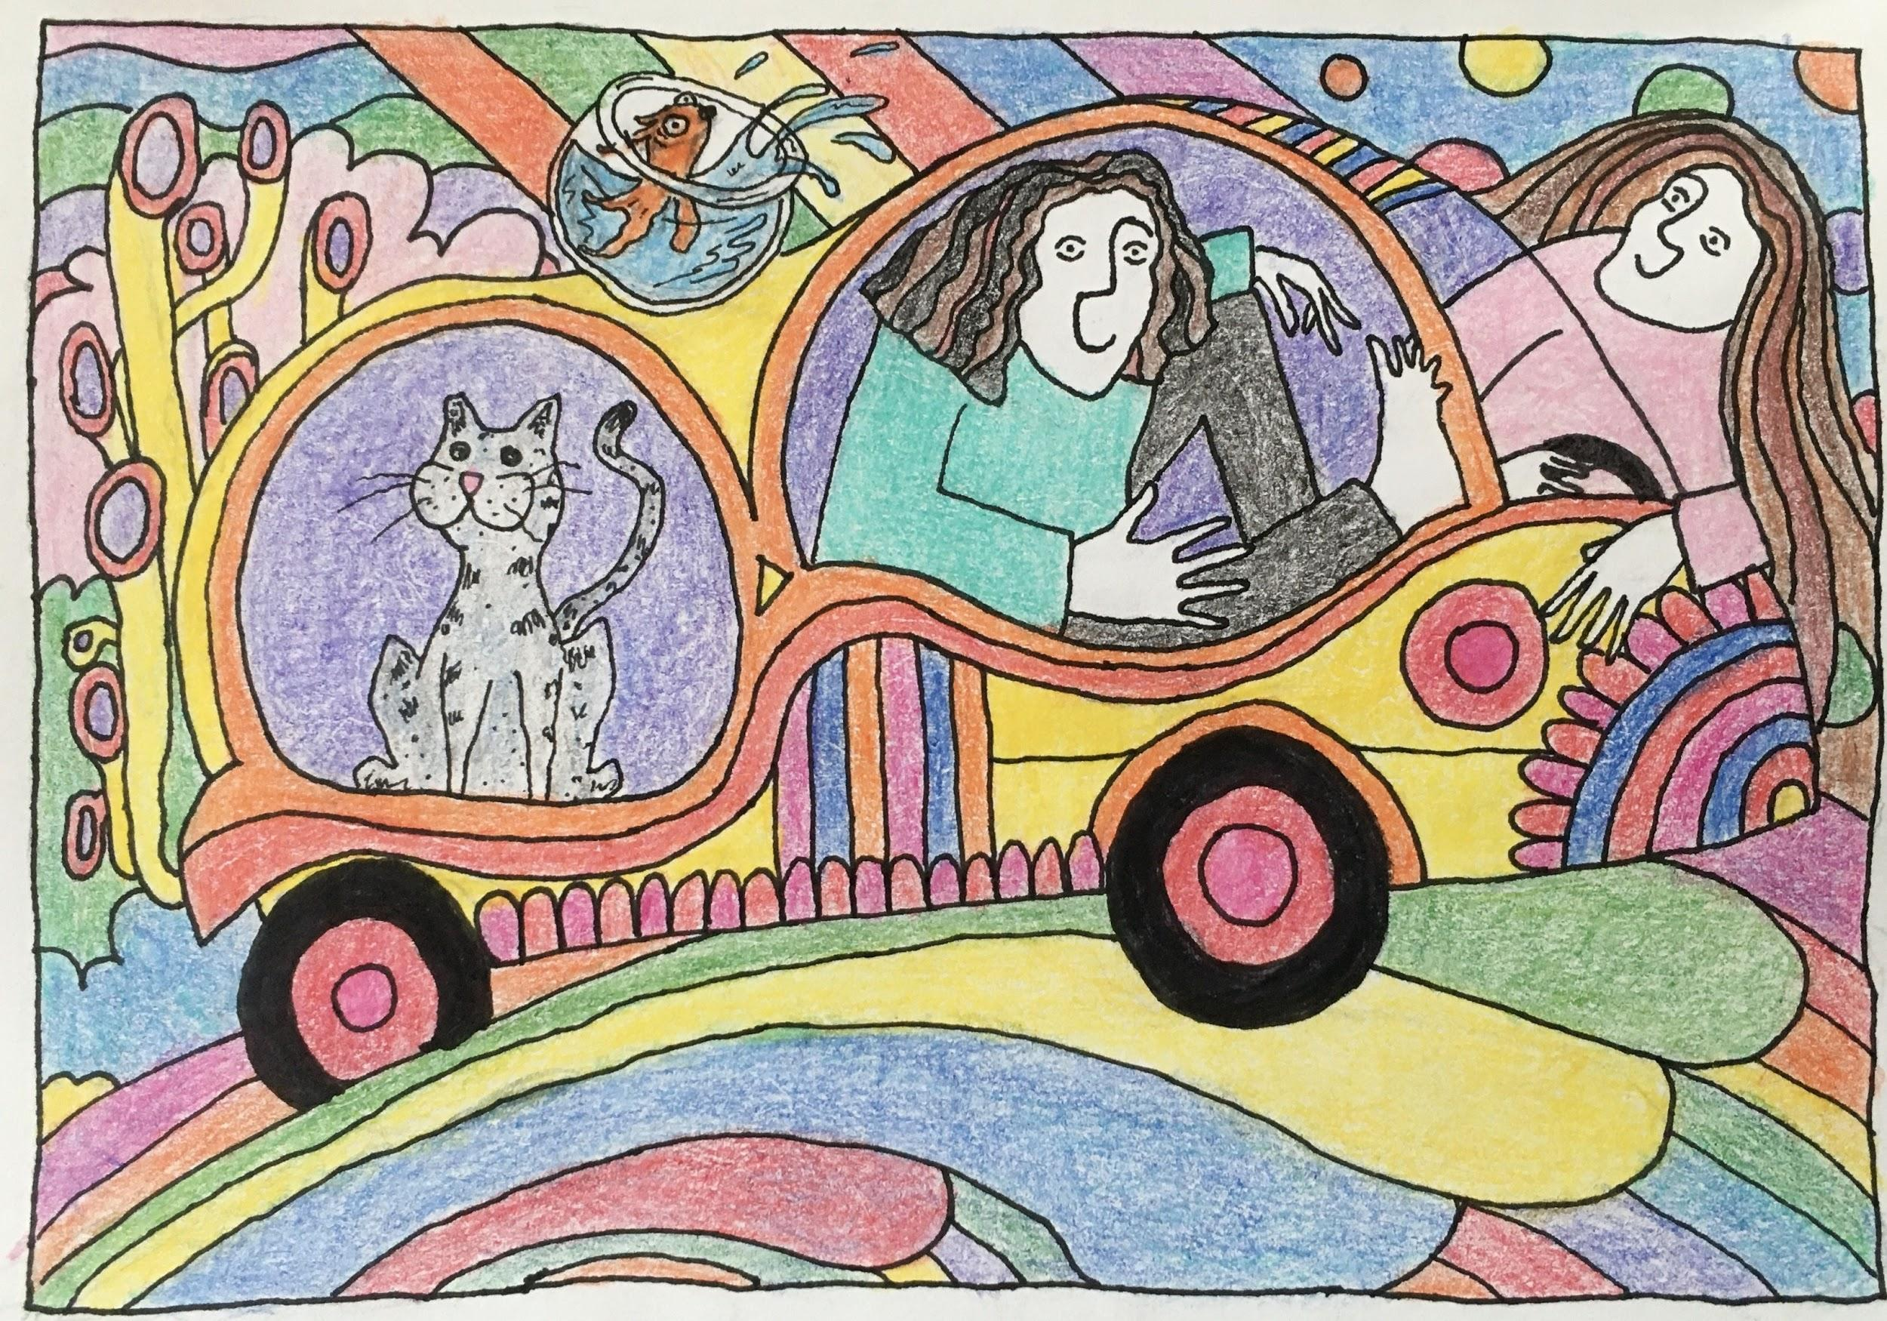

Slide 13
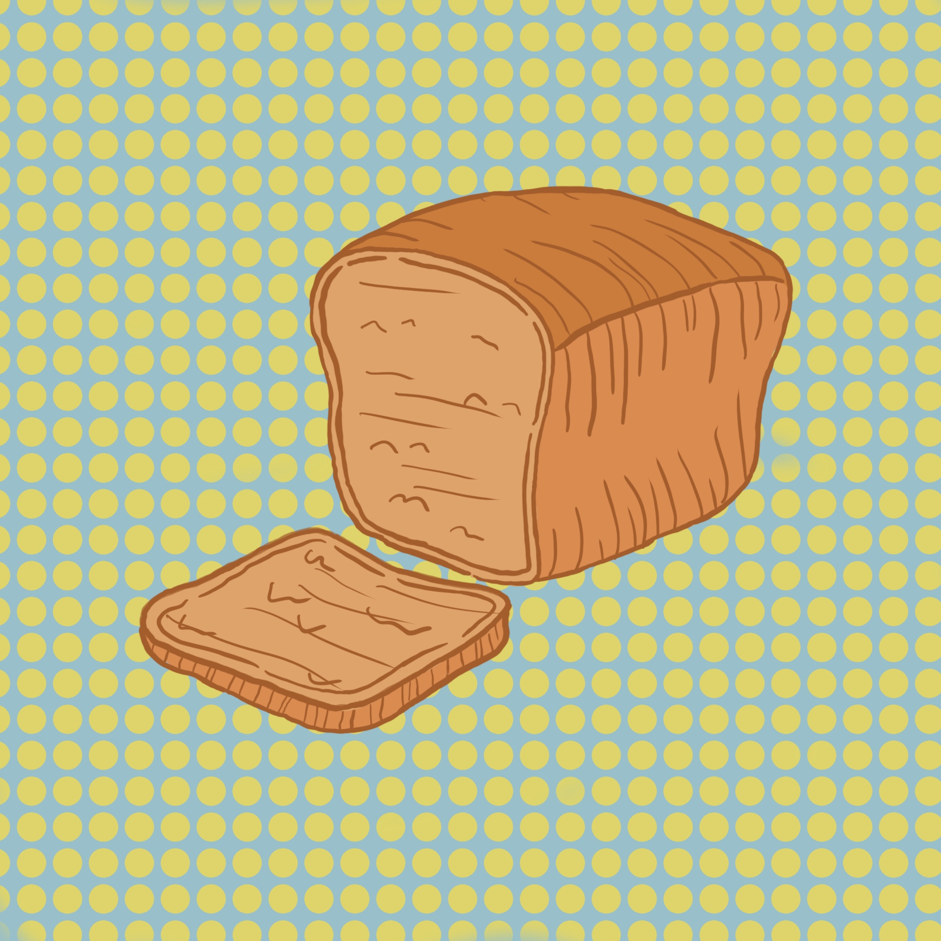
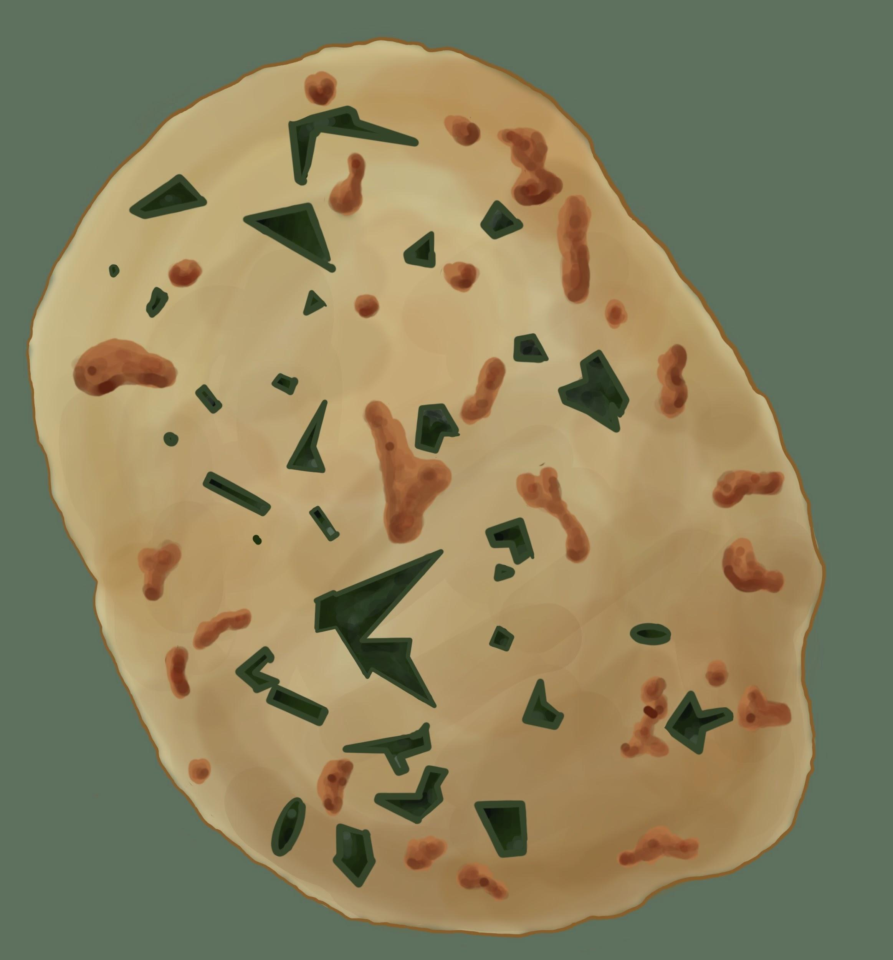
Week 7

Slide 14

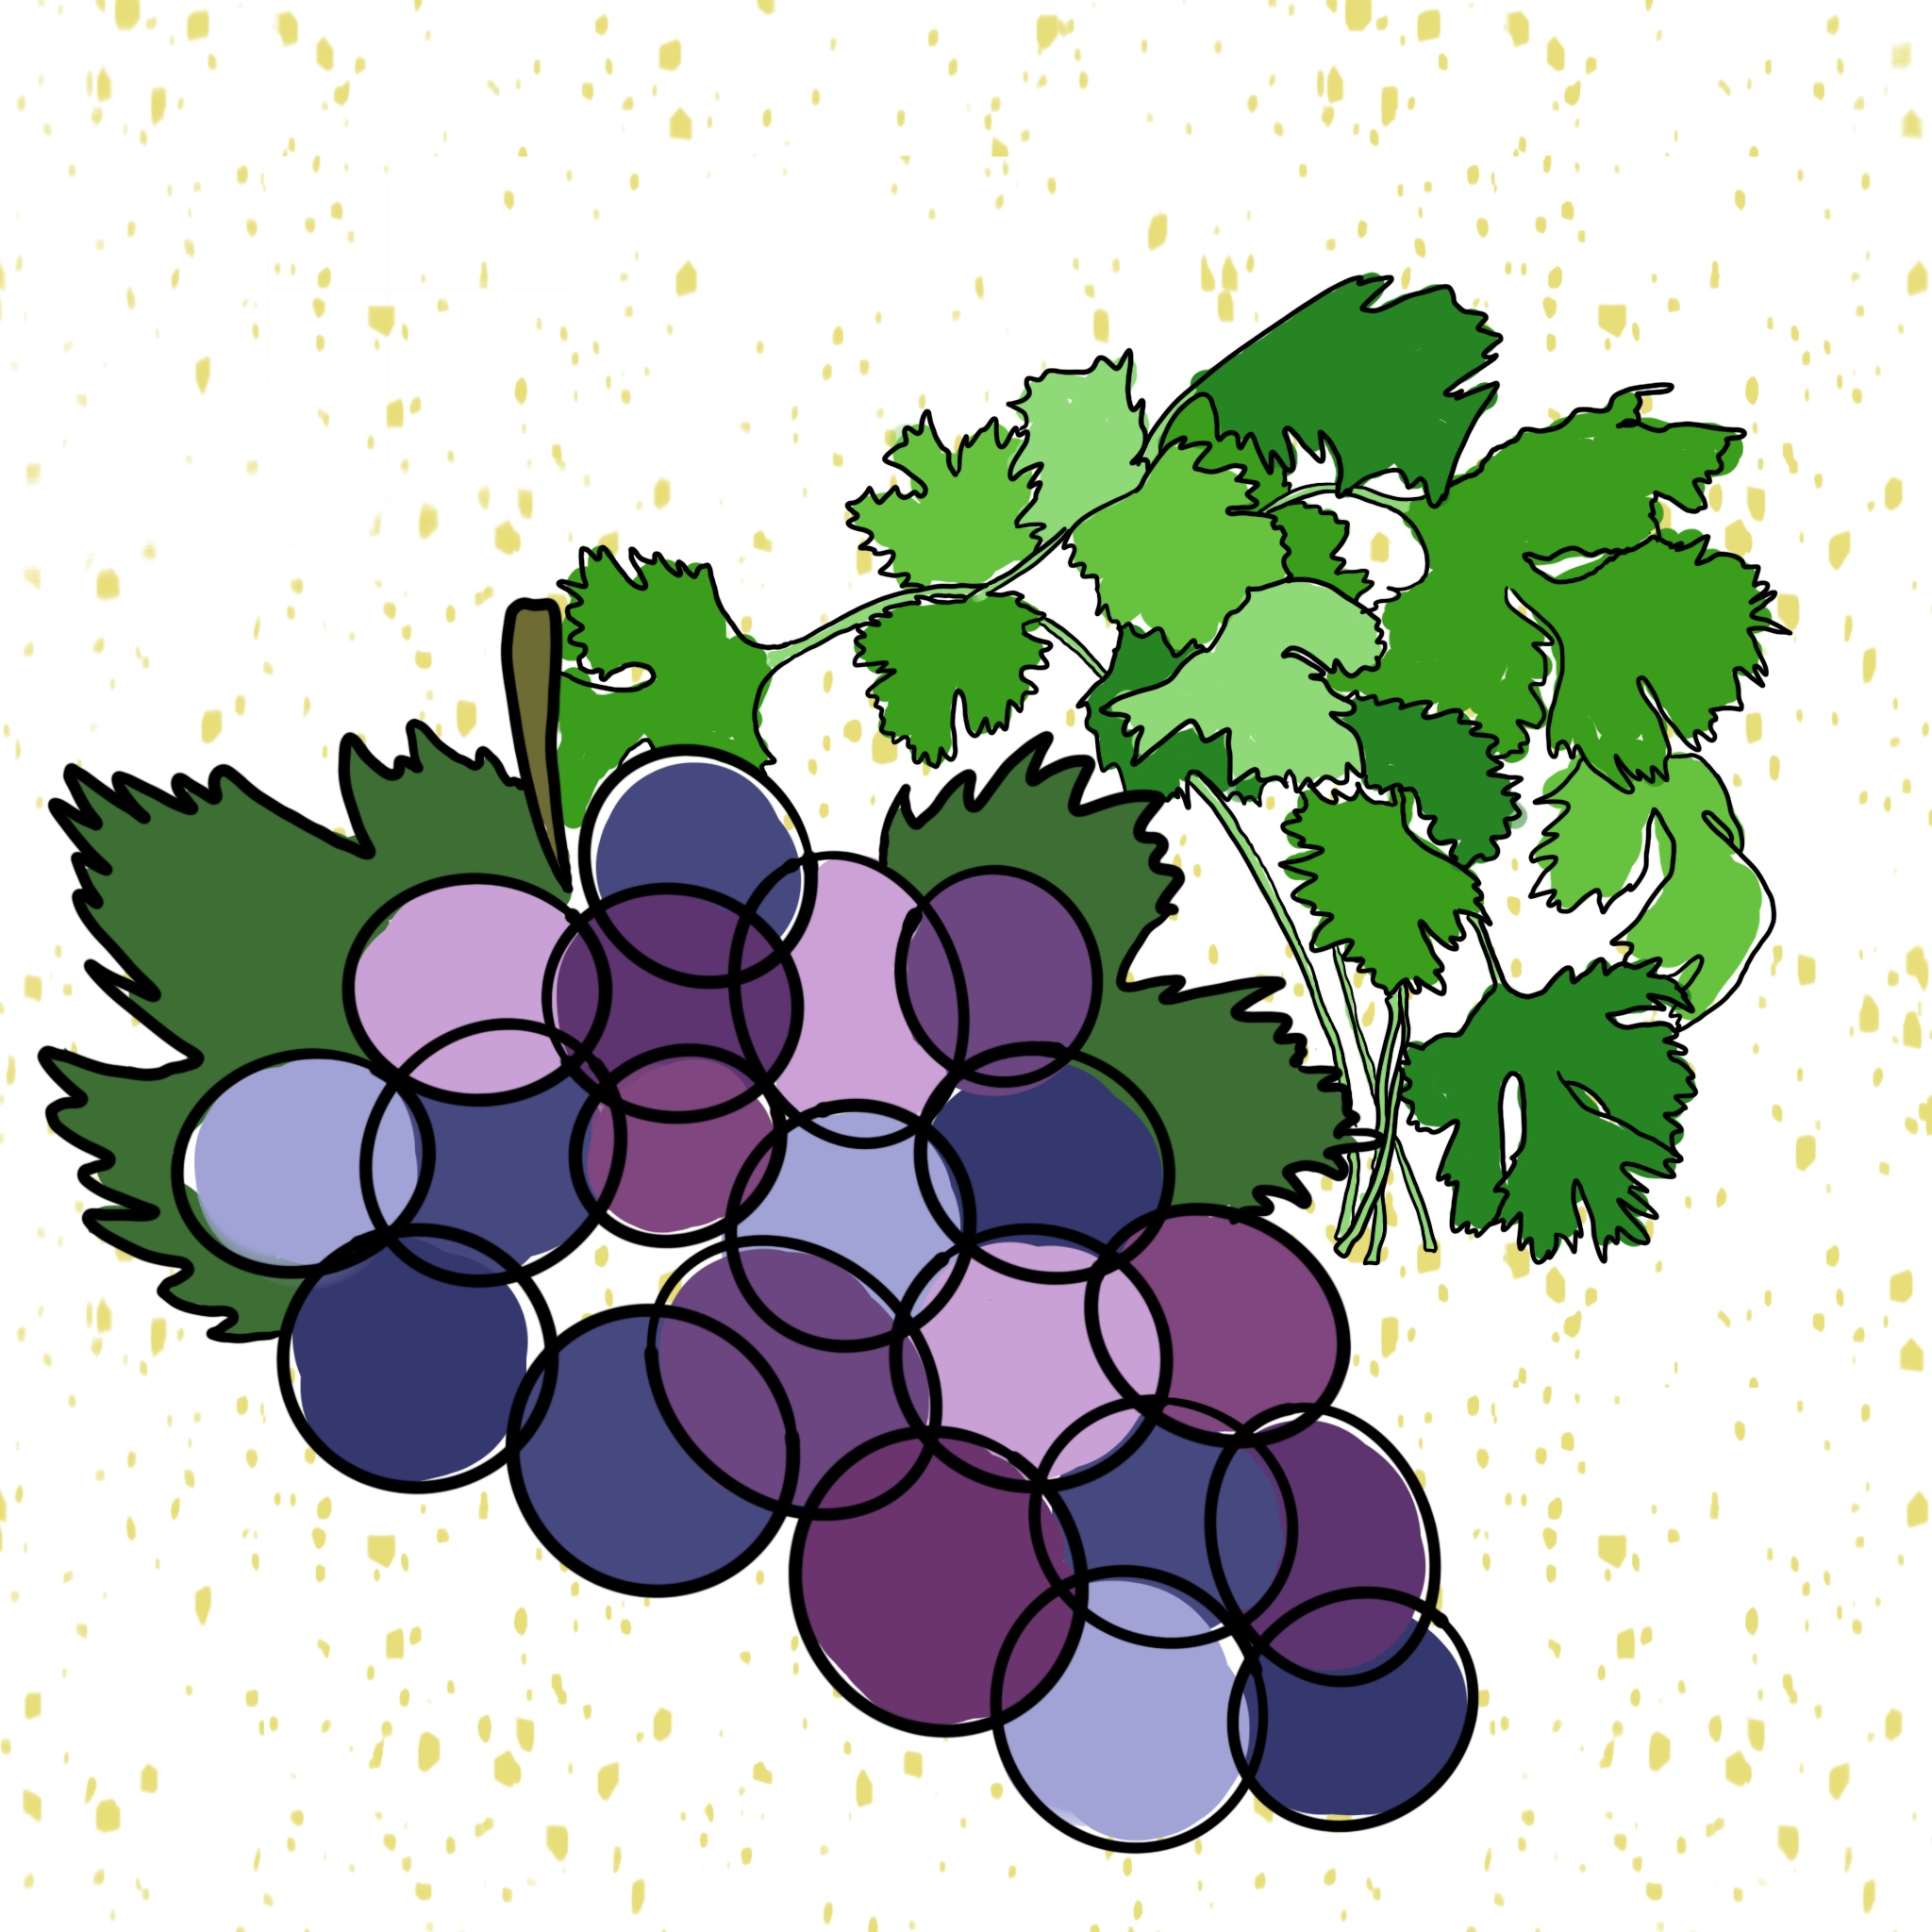

Slide 15
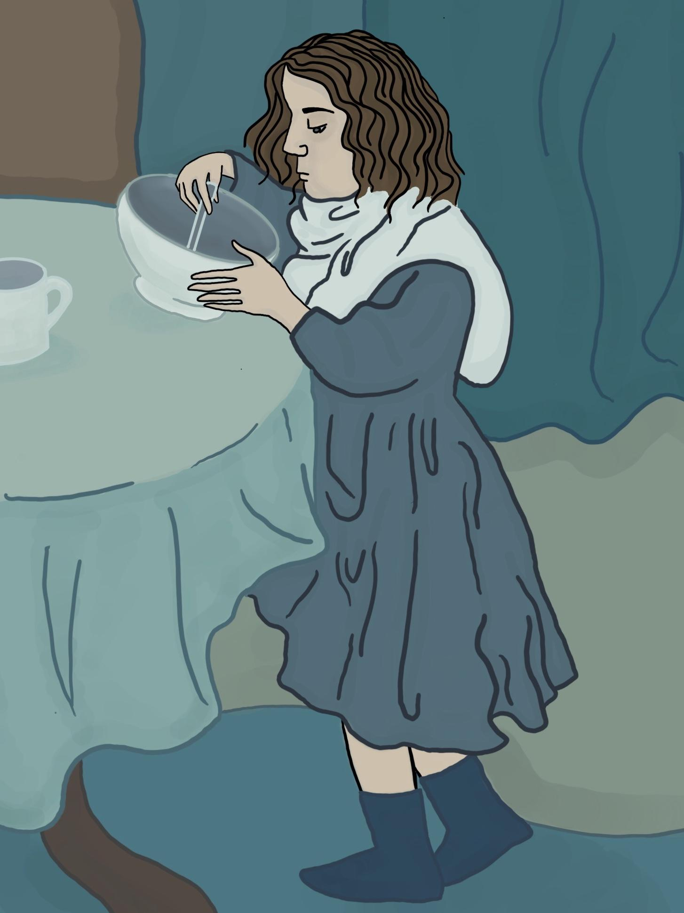

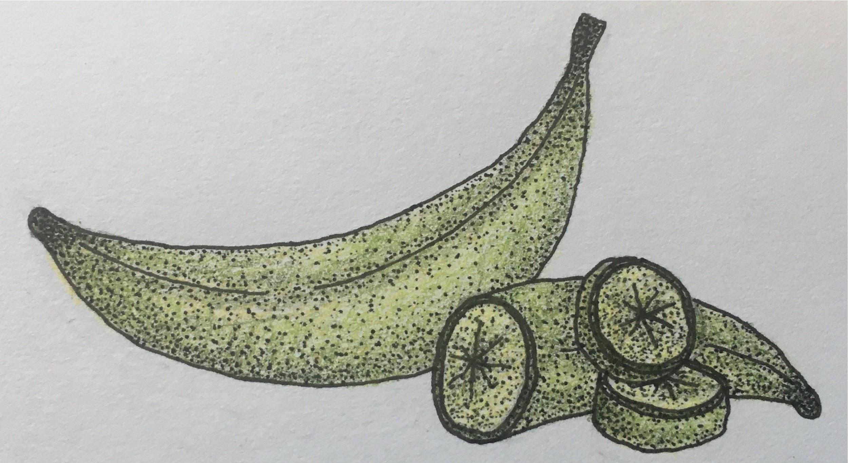
Week 3

Slide 16
Choice Cuts
“Gourmandism, considered as part of a political economy, is a common tie which binds nations together by reciprocal exchange of objects which are part of their daily food. It is something which makes… provisions of every kind, travel from one end of the world to the other” (Anthelme, 2002, p. 21).

Slide 17
“For nearly 35,000 years, the capacity to communicate through art has supplemented and enhanced spoken and written language” (Dimaggio).

Slide 18
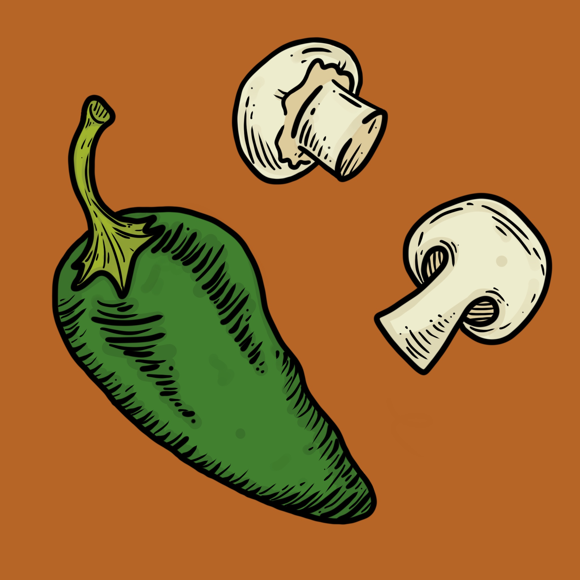

Week 8

Slide 19
Week 10
“I learned a lot about art, especially digital art, and I’m excited to keep learning more. I progressed a lot with technology, time management, cooking, reading, writing, and web design. I completed illustrations with multiple mediums (pen, colored pencil, watercolor, and digital) and I can say that I am proud of every single one of them. I also learned a lot about food, art, and culture, and how they affect each other.”

Slide 20
Dimaggio, P. (2010) Art in the Lives of Immigrant Communities in the United States. P. 38
Dunlop, F. (2008) Shark’s Fin and Sichuan Pepper: A Sweet-Sour Memoir of Eating in China. P. 262
Koppelman, N. (2020, May, 25) Context is all: Historical and Ethical Perspectives on the COVID-19: Moment. Lecture in Olympia, Wa.
Kurlansky, M. (2002) Choice Cuts: A Savory Selection of Food Writing From Around the World and Throughout History. P. 21
Williams, S. (2020, May, 5) Eating During COVID-19: Food Banks and Cooking With Food Insecurity. Lecture in Olympia, Wa.
Thank You

